Slide 1

RentRide
Mandip Raut

Slide 2

Introduction
RentRide is a platform where users can rent vehicles and lend their own vehicles.
Provides an easy and secure way to access vehicles on demand.
Addresses the growing need for flexible transportation options.

Slide 3

Problem Statement
Limited access to short-term vehicle rentals.
Vehicle owners have idle cars that could generate income.
Need for a trusted platform to connect renters and vehicle owners.

Slide 4

Objectives
Develop a user-friendly vehicle rental platform.
Ensure secure transactions and verification processes.
Provide seamless booking functionalities.

Slide 5
System Architecture
User Registration & Authentication
Vehicle Listing & Searching
Booking & Payment Processing
Admin Panel for Monitoring
Reviews & Ratings System

Slide 6





Methodology
Technologies Used:
React (Frontend), Node.js (Backend), MongoDB (Database)
Agile development approach with iterative improvements.
Khalti Integration for secure payment.
Post Man for API testing.

Slide 7
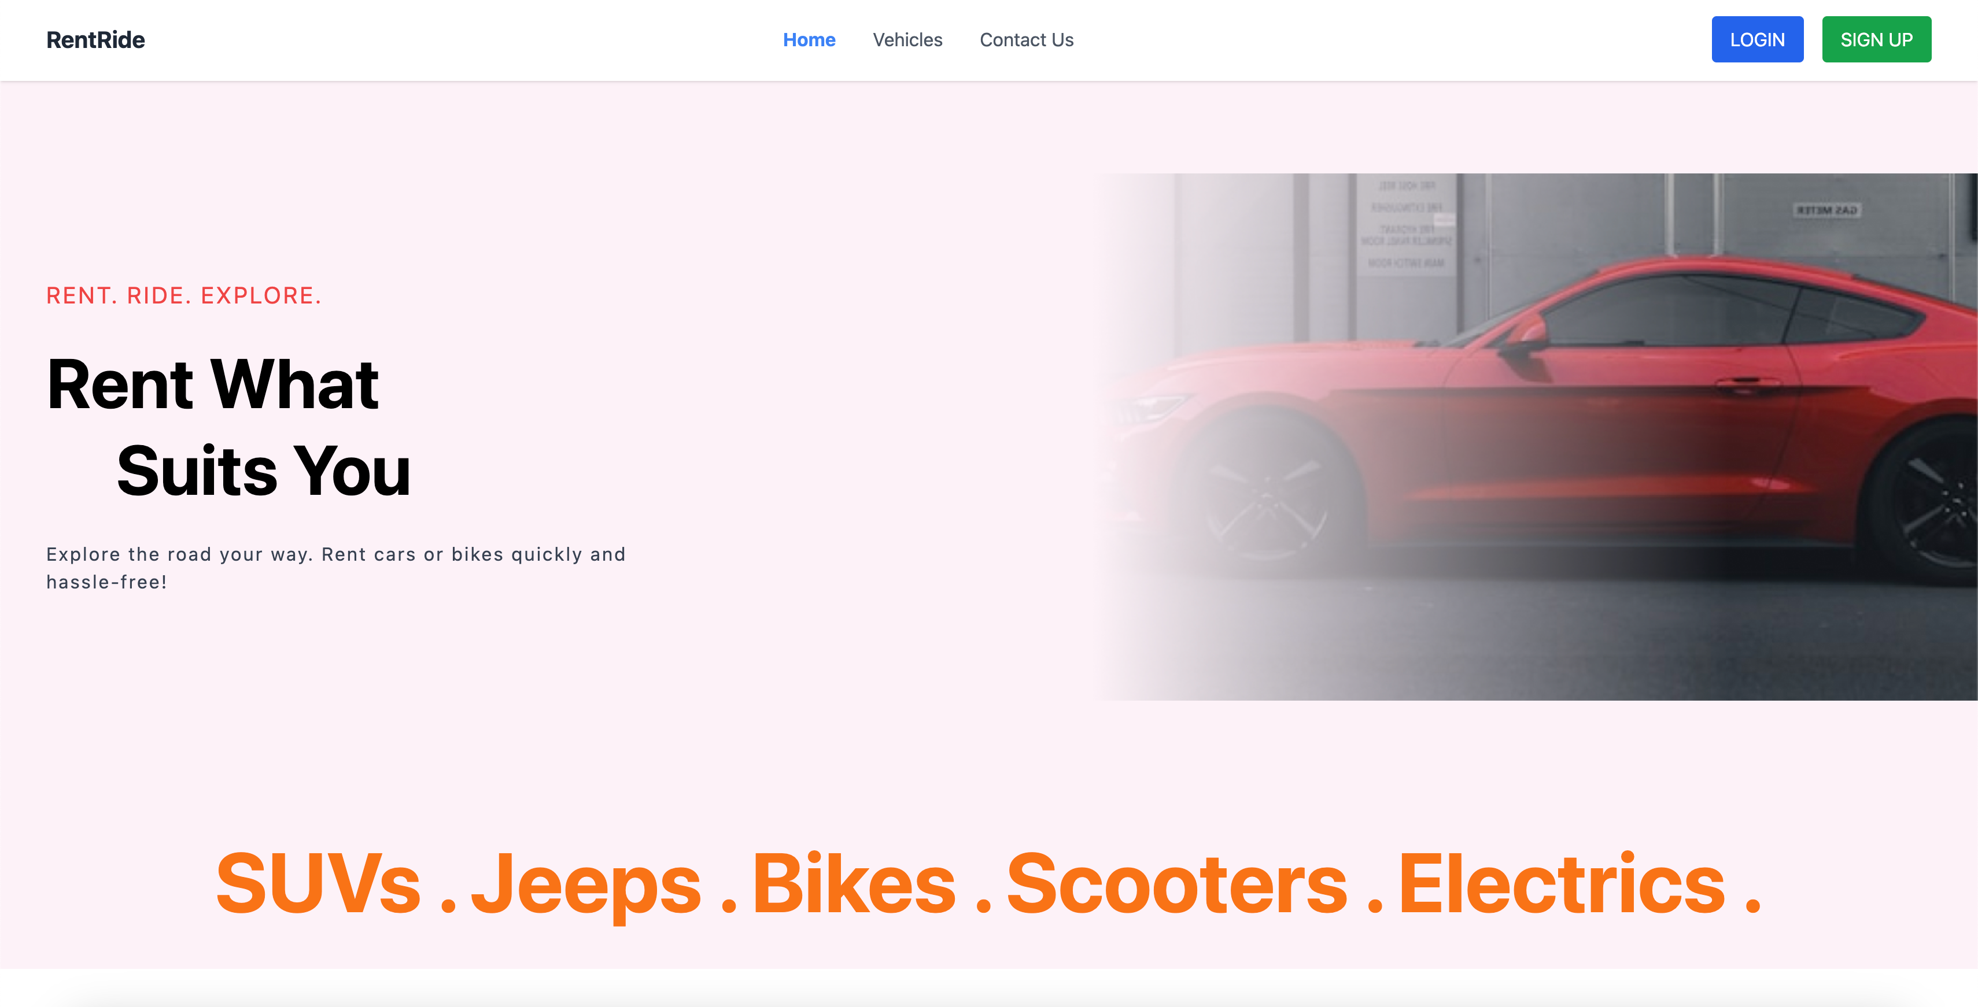
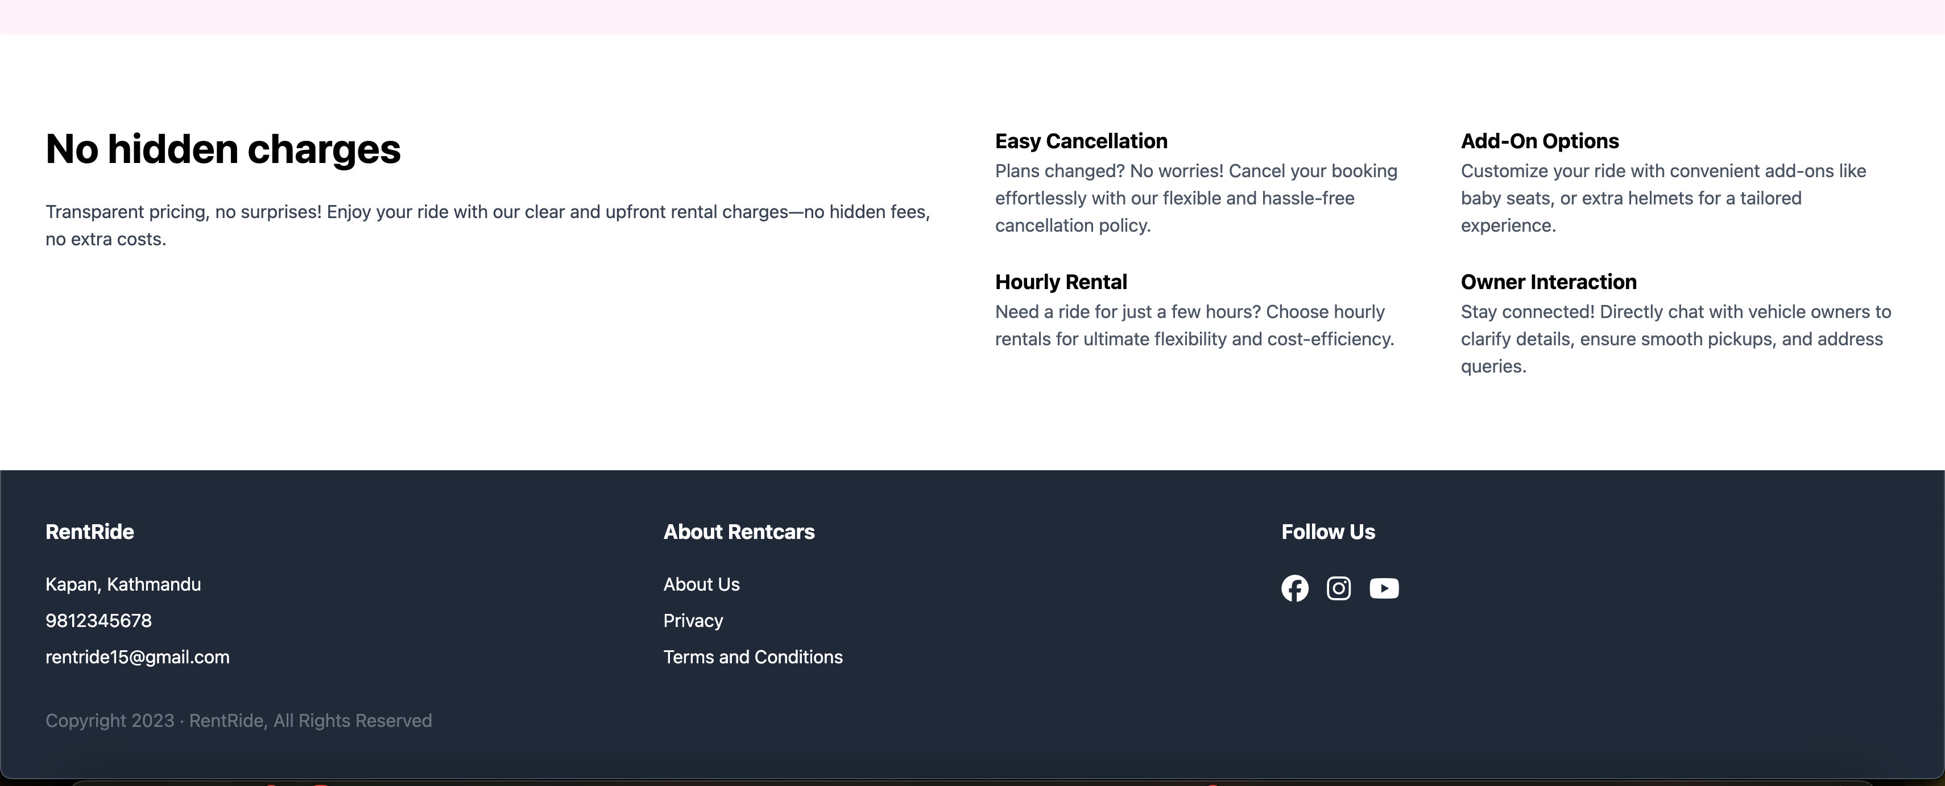
Implementation

Slide 8
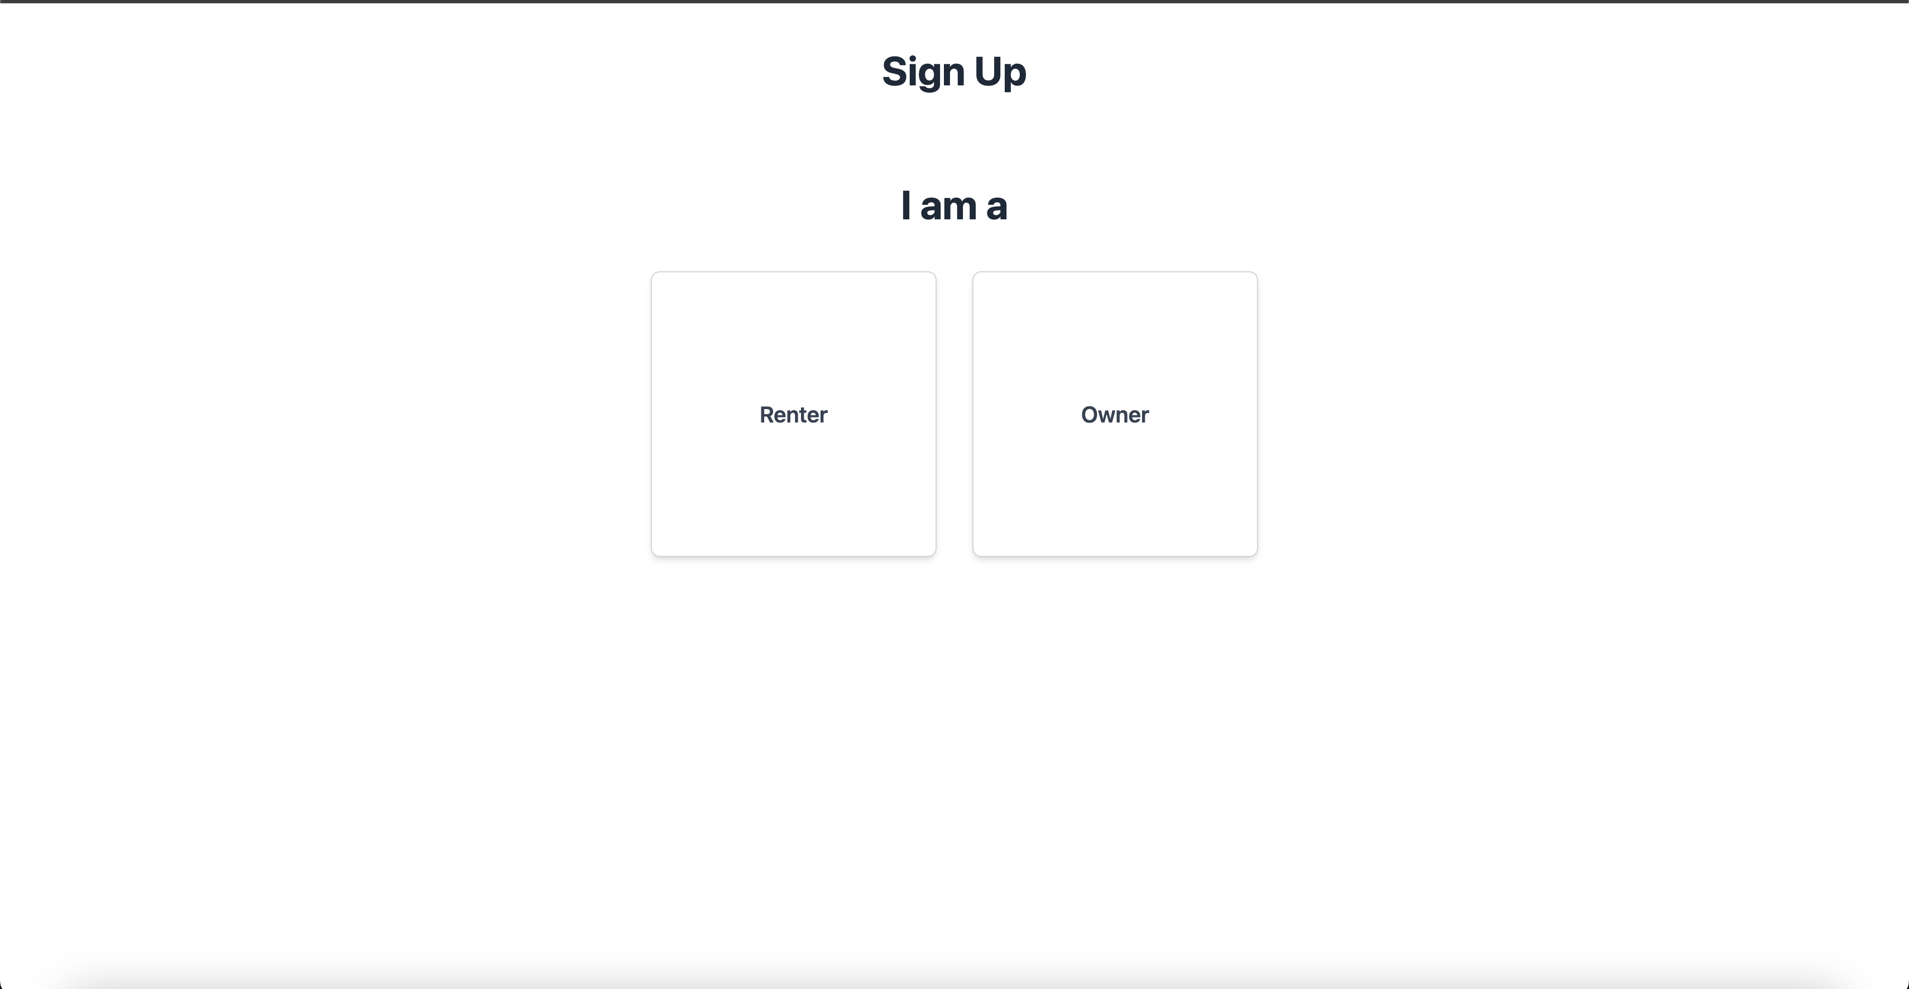
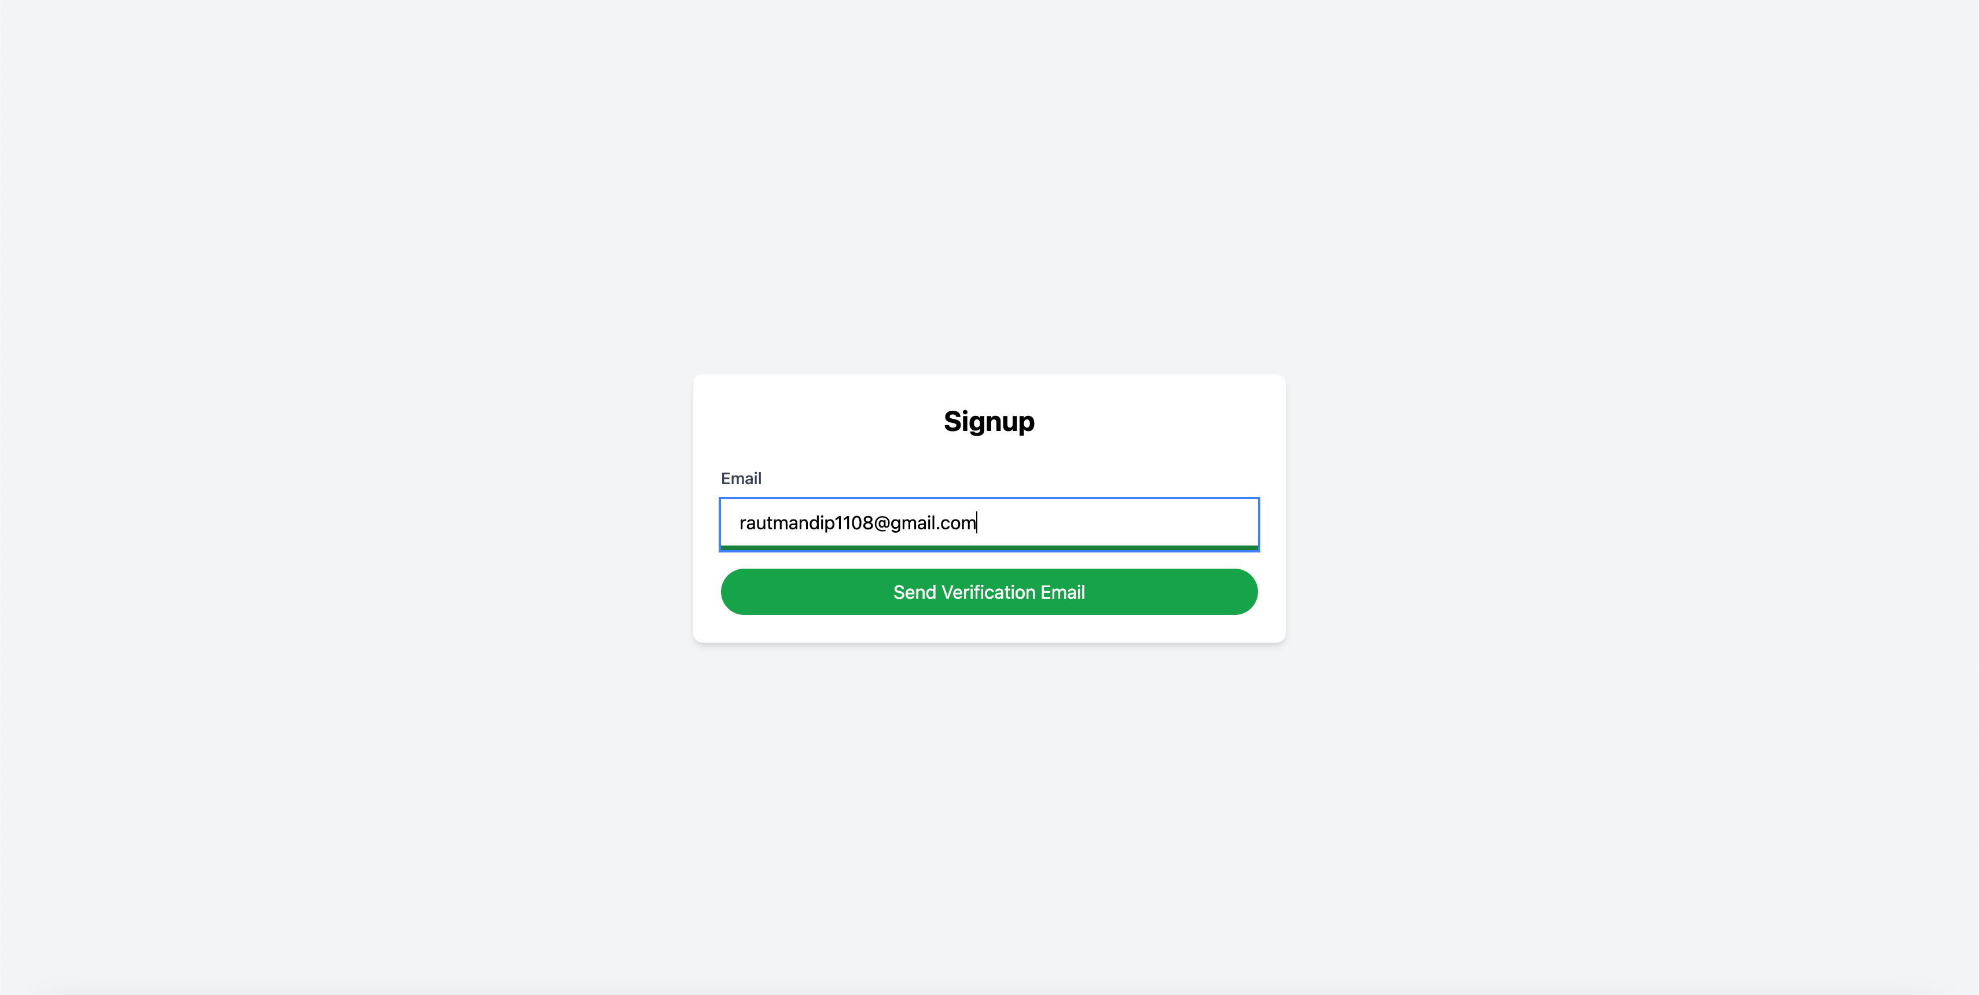
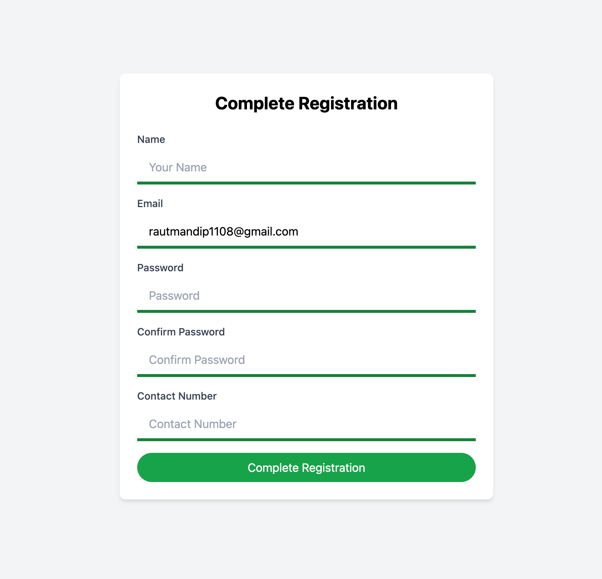
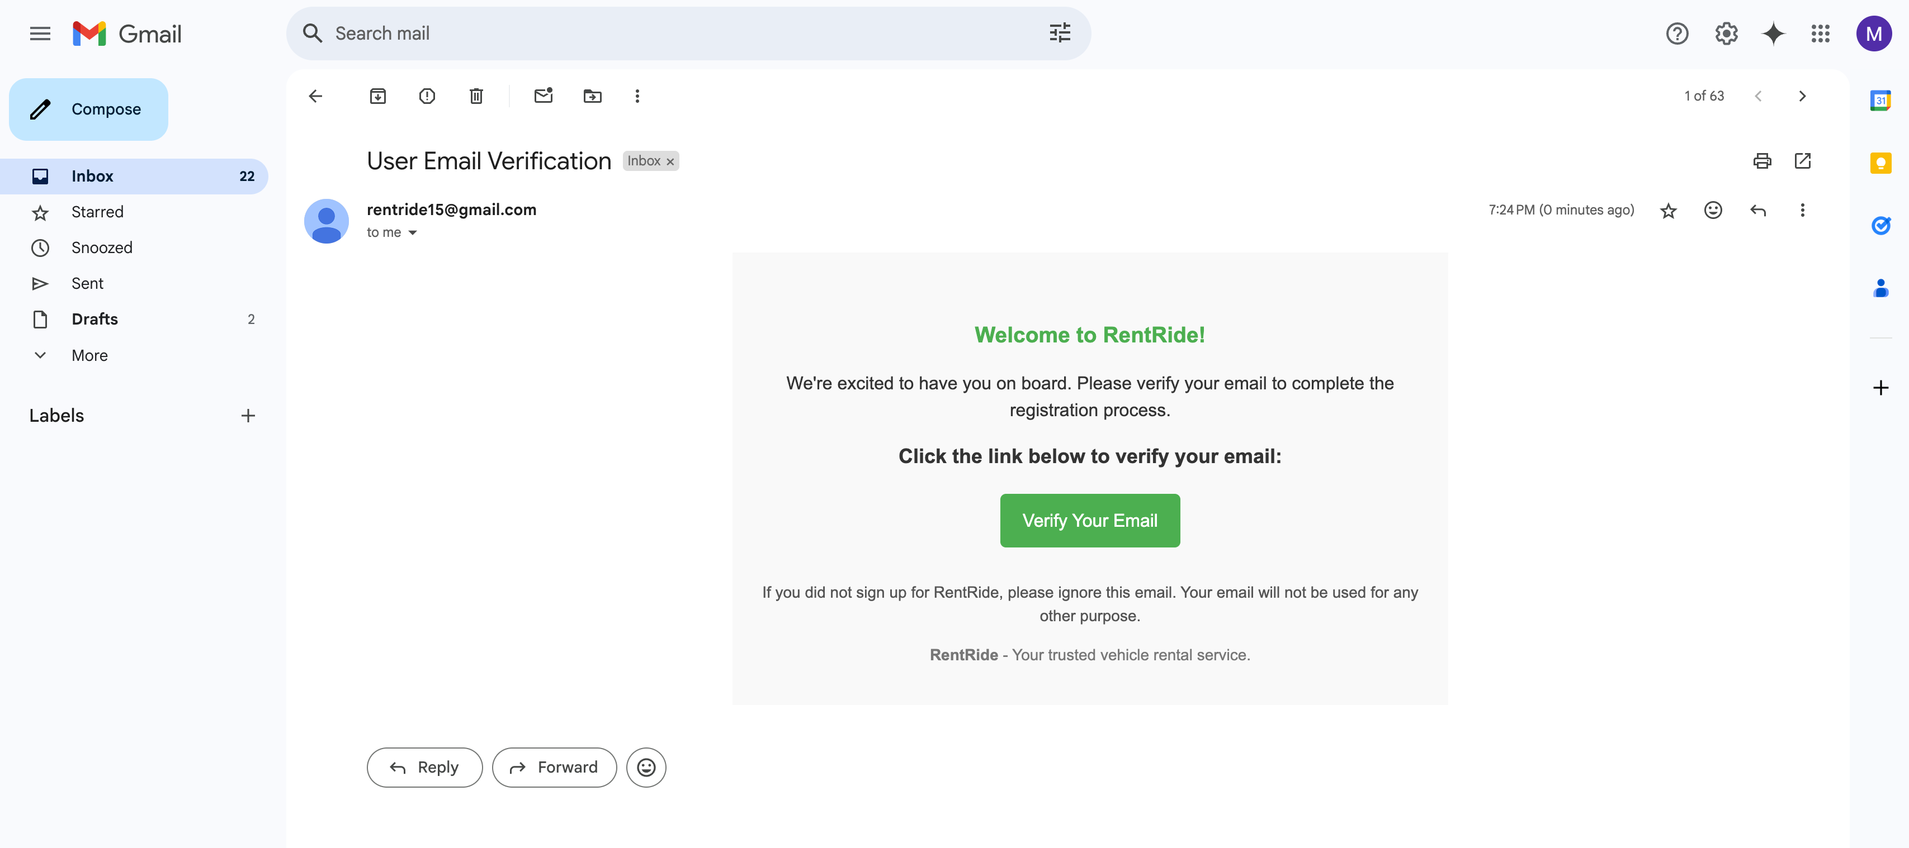
Login and Signup

Slide 9
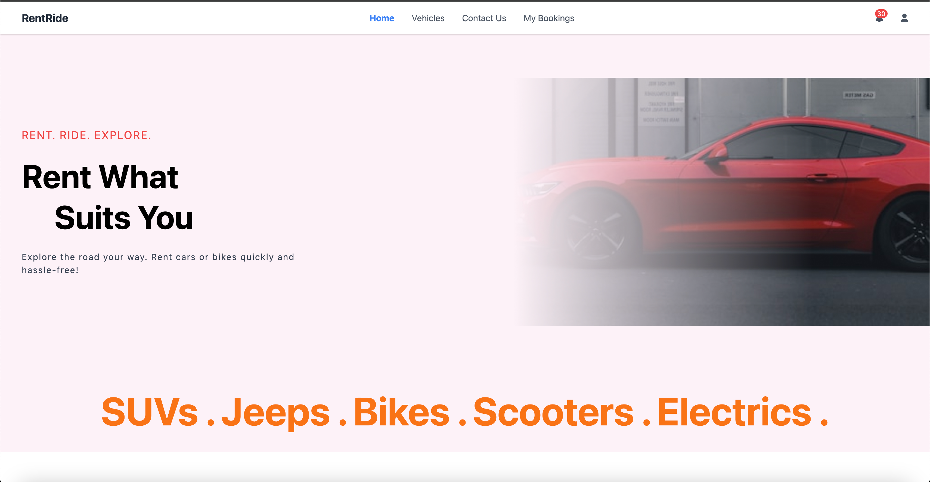
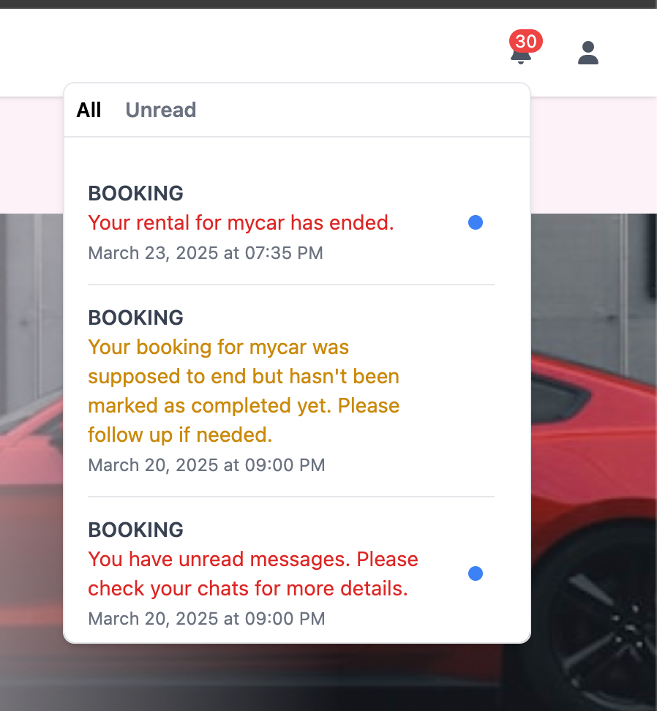
Home Page

Slide 10
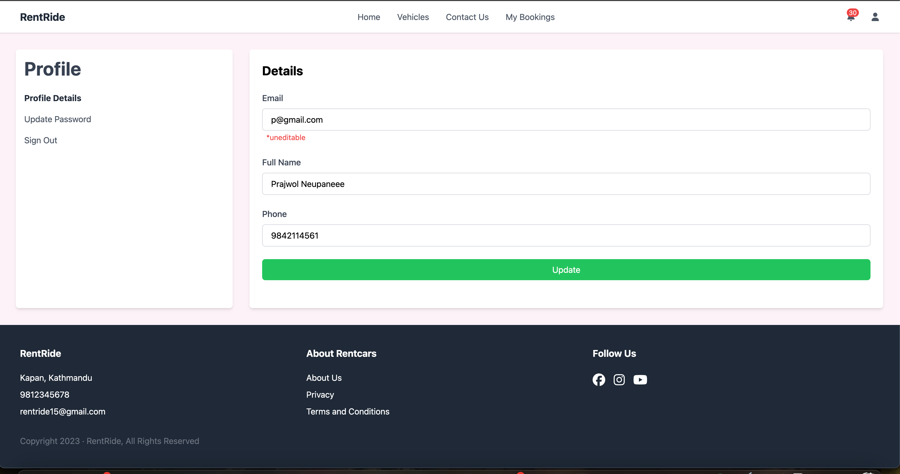
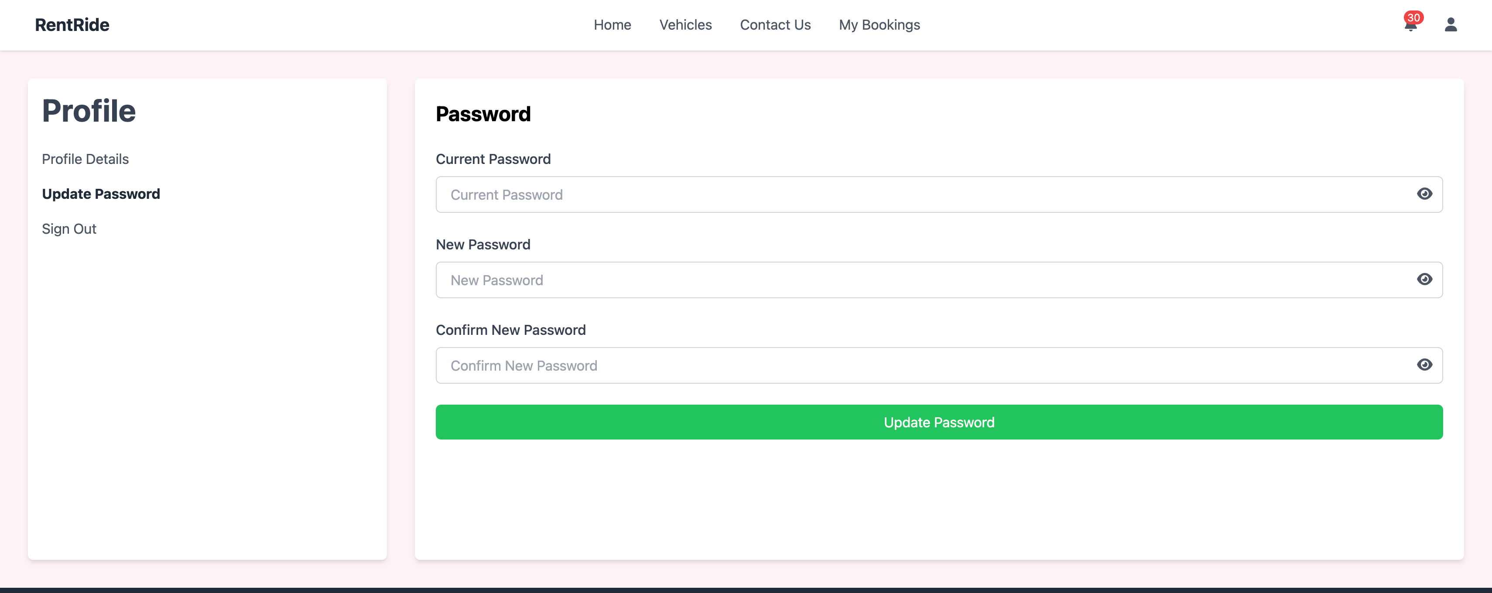
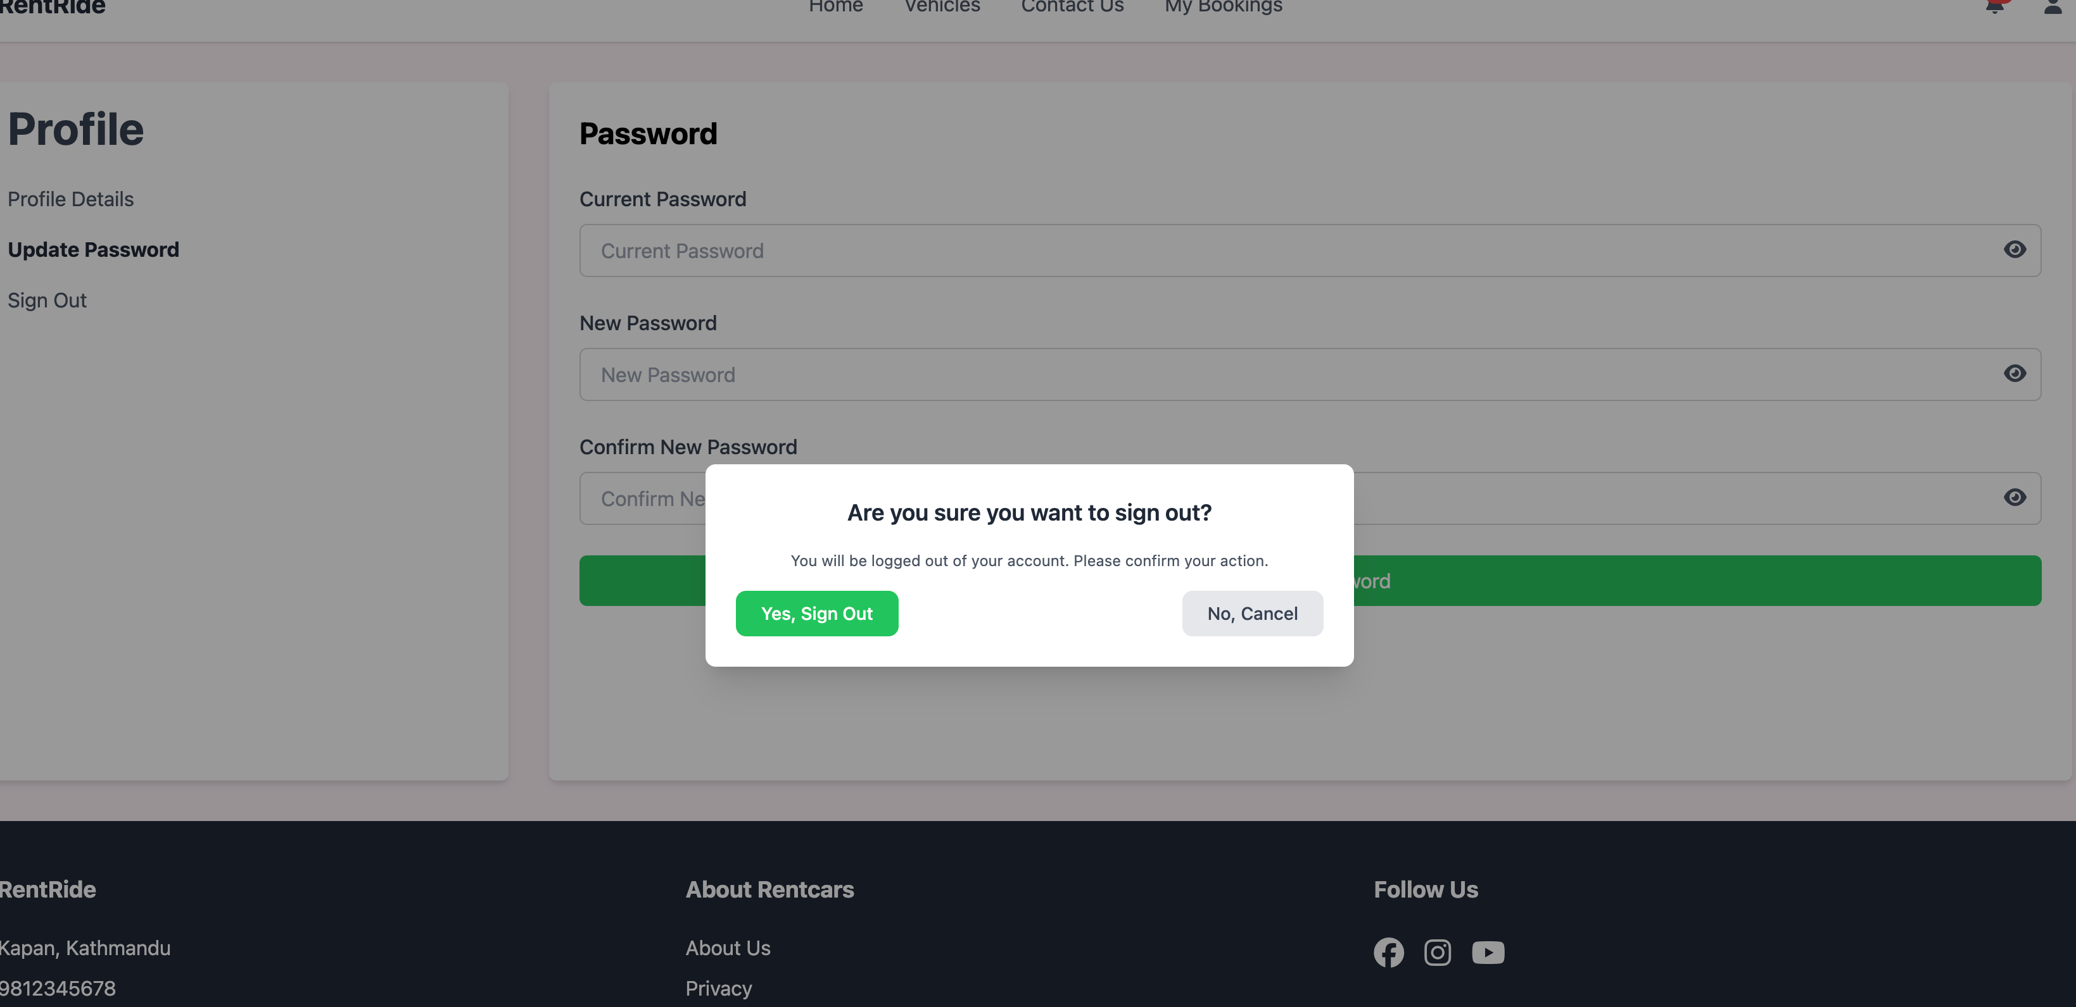
Profile Page

Slide 11
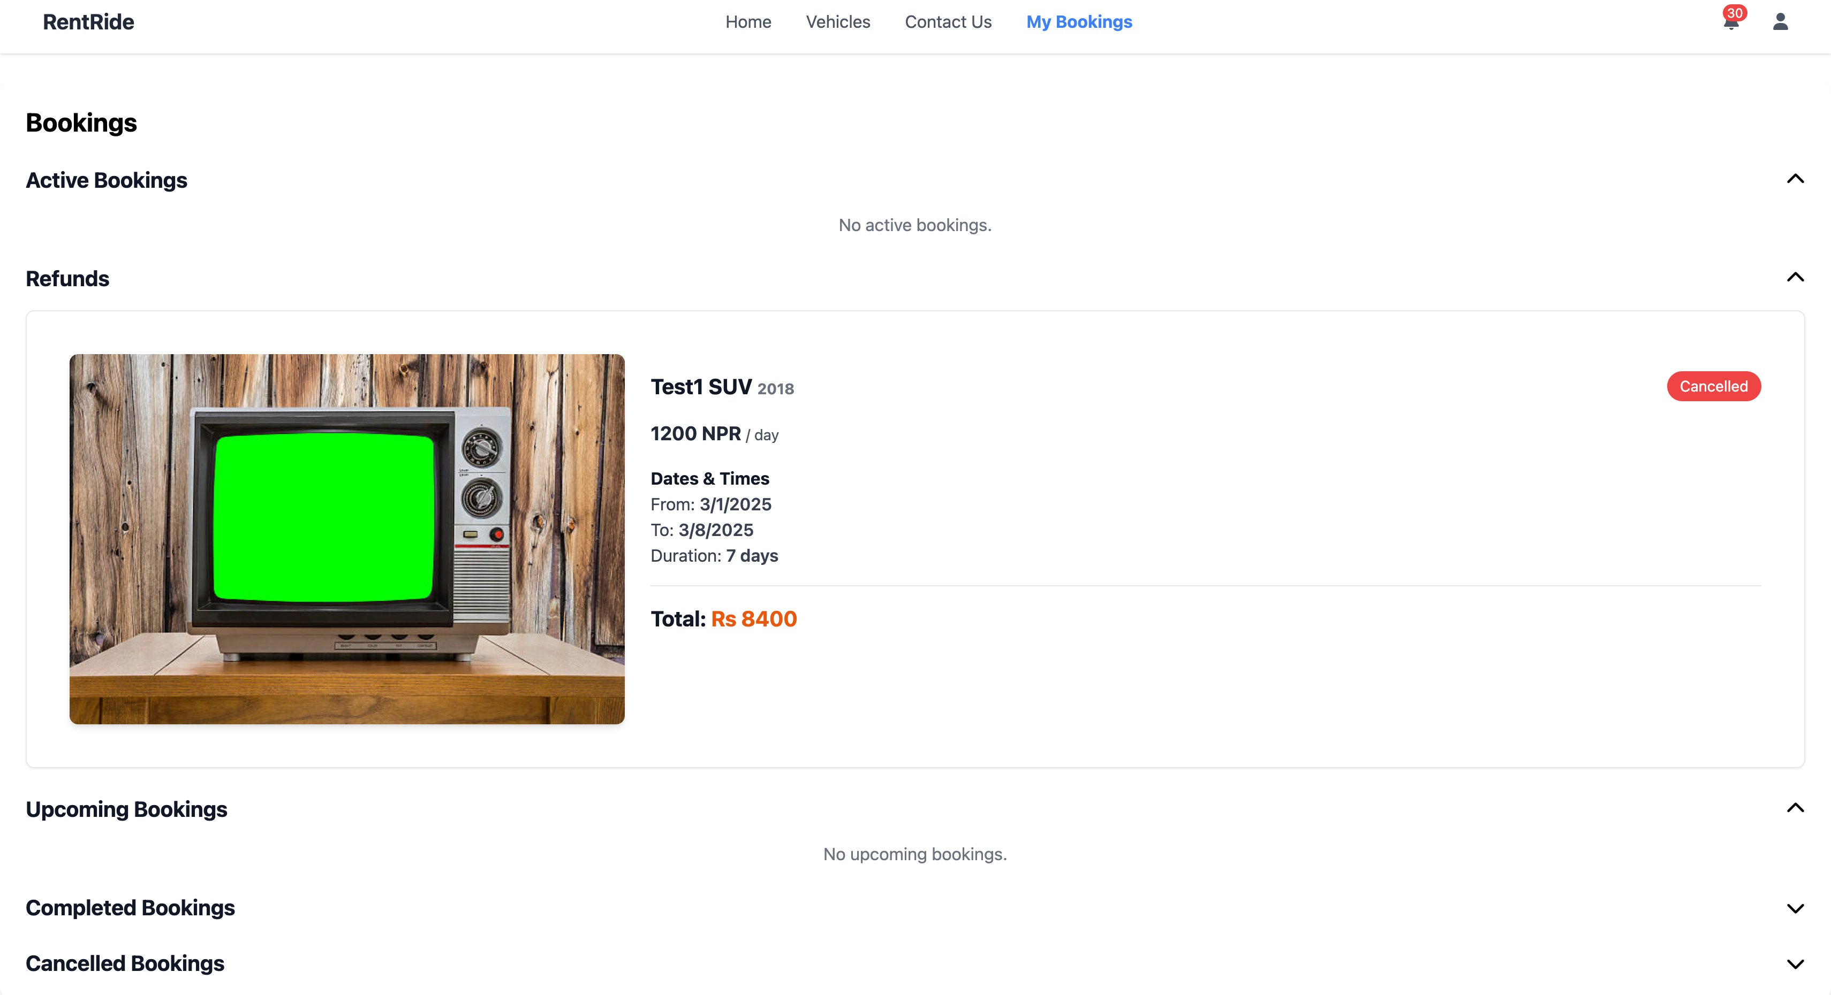
Bookings Page (User)

Slide 12
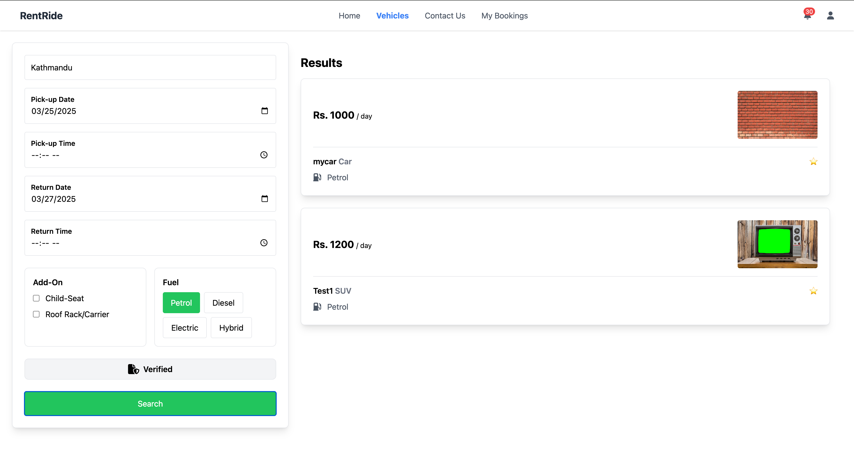
Vehicle Search

Slide 13
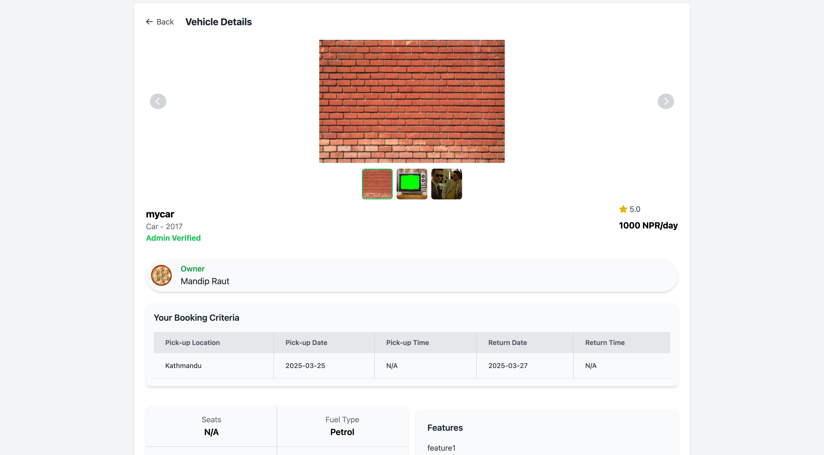
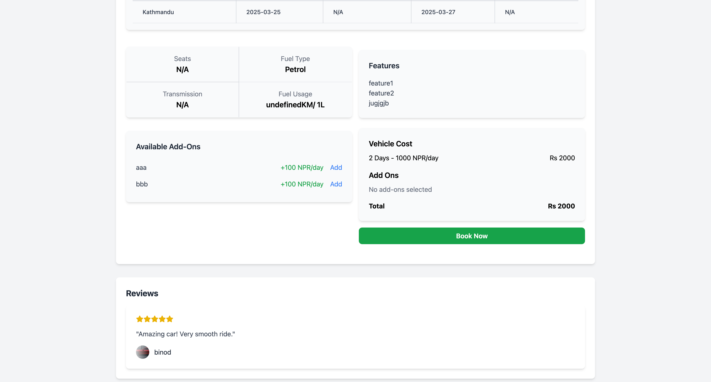
Vehicle Details

Slide 14
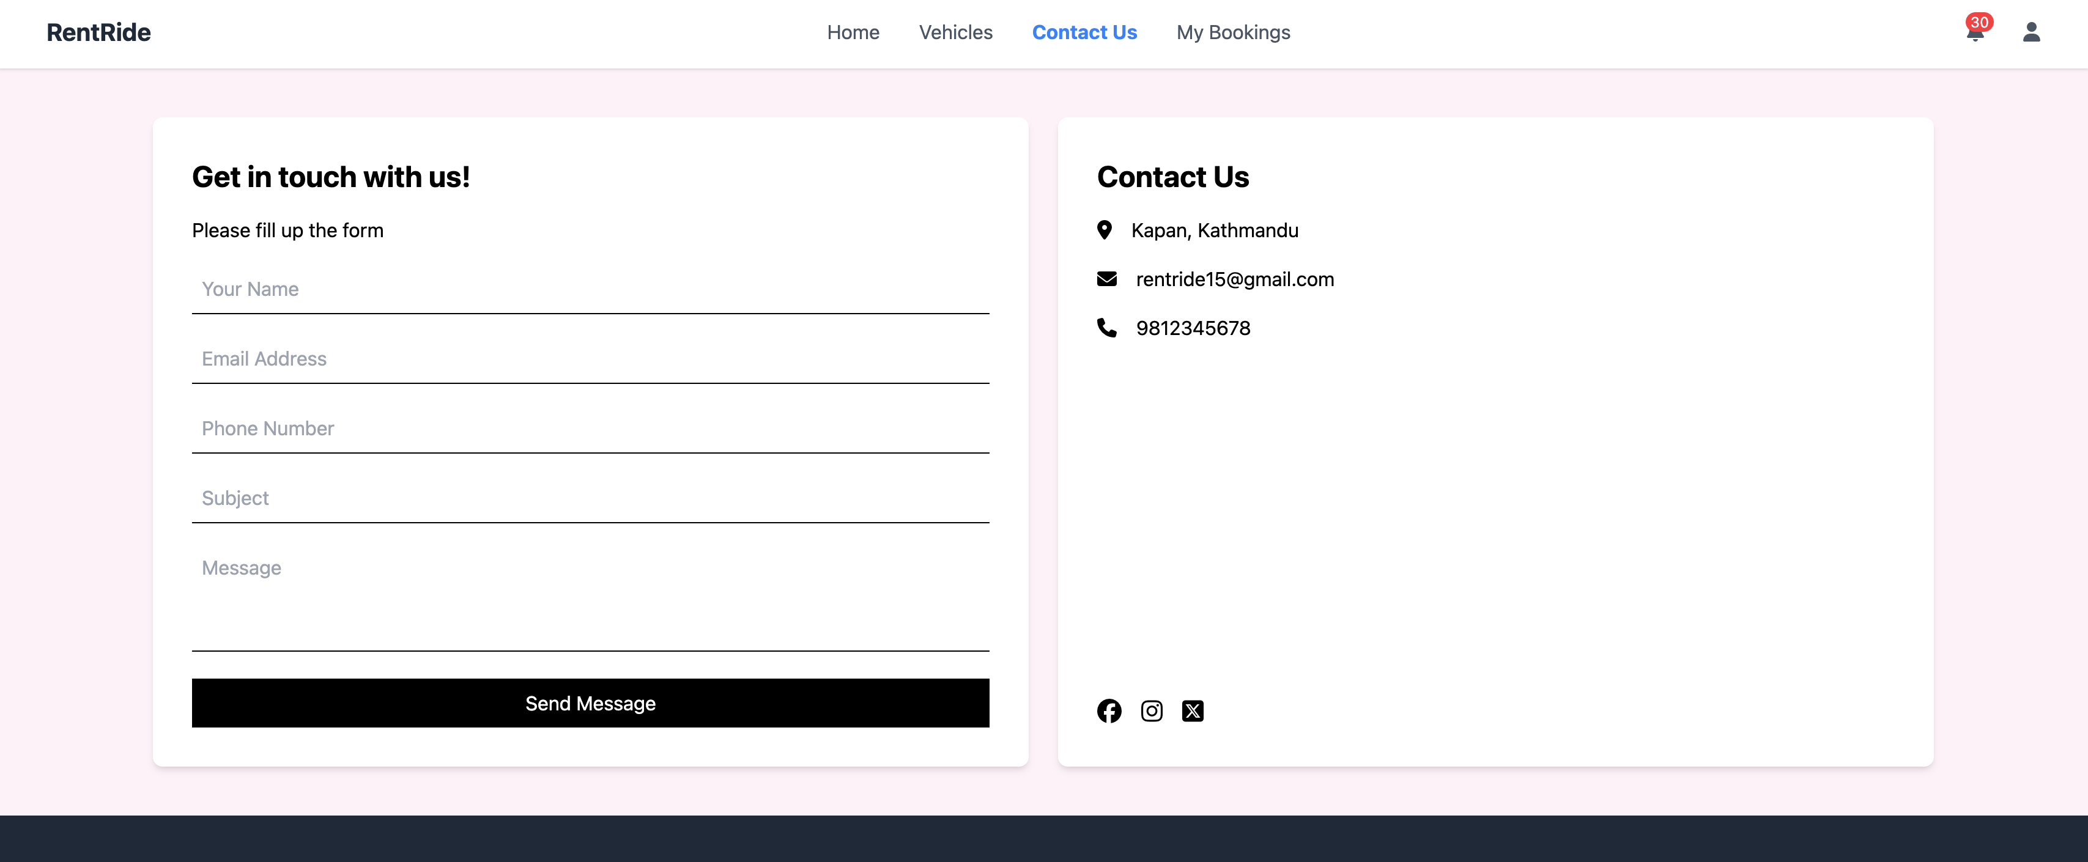
Contact Us Page

Slide 15
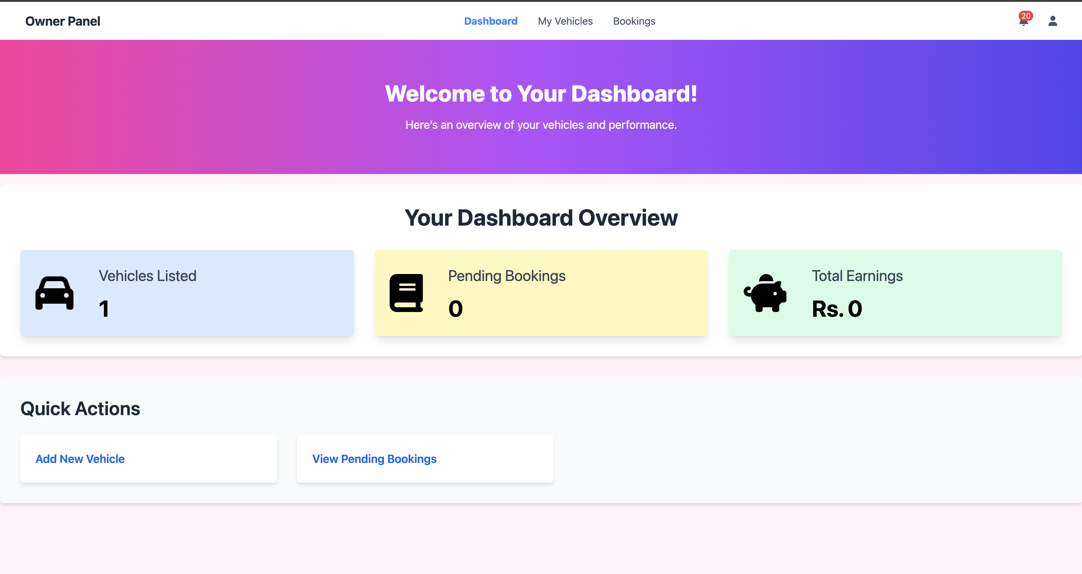
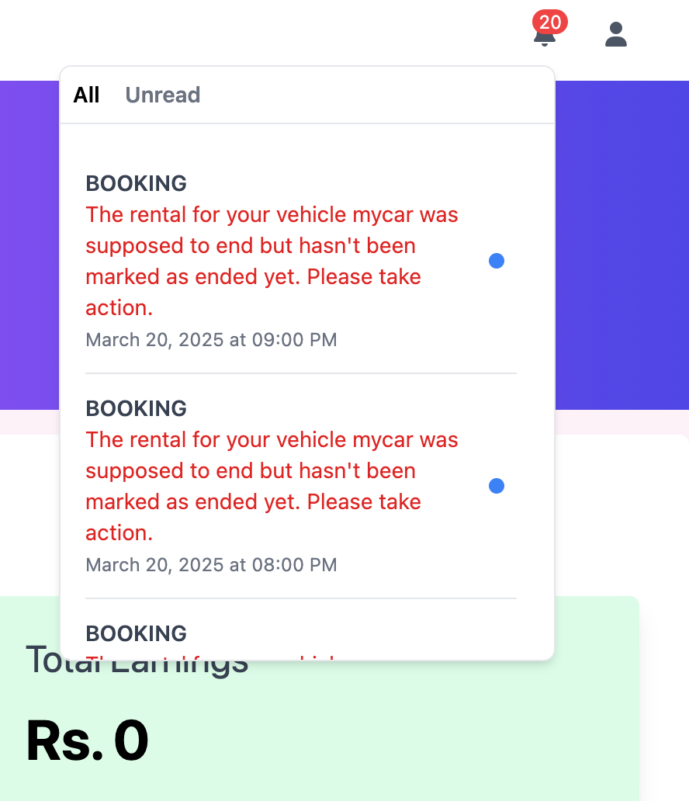
Owner Side

Slide 16
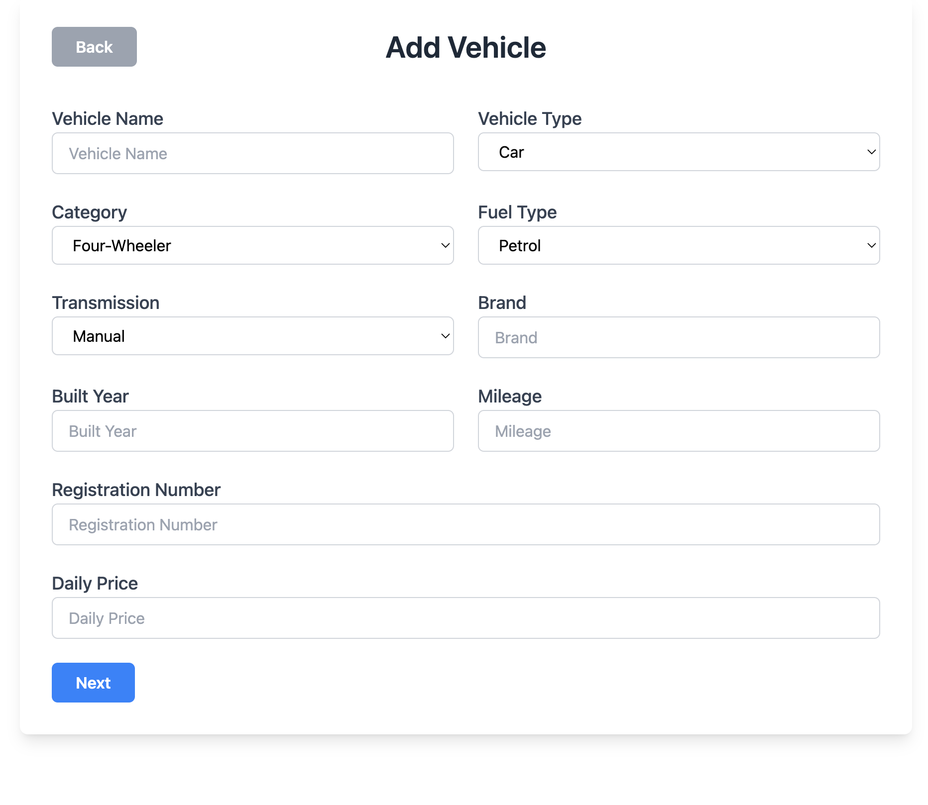
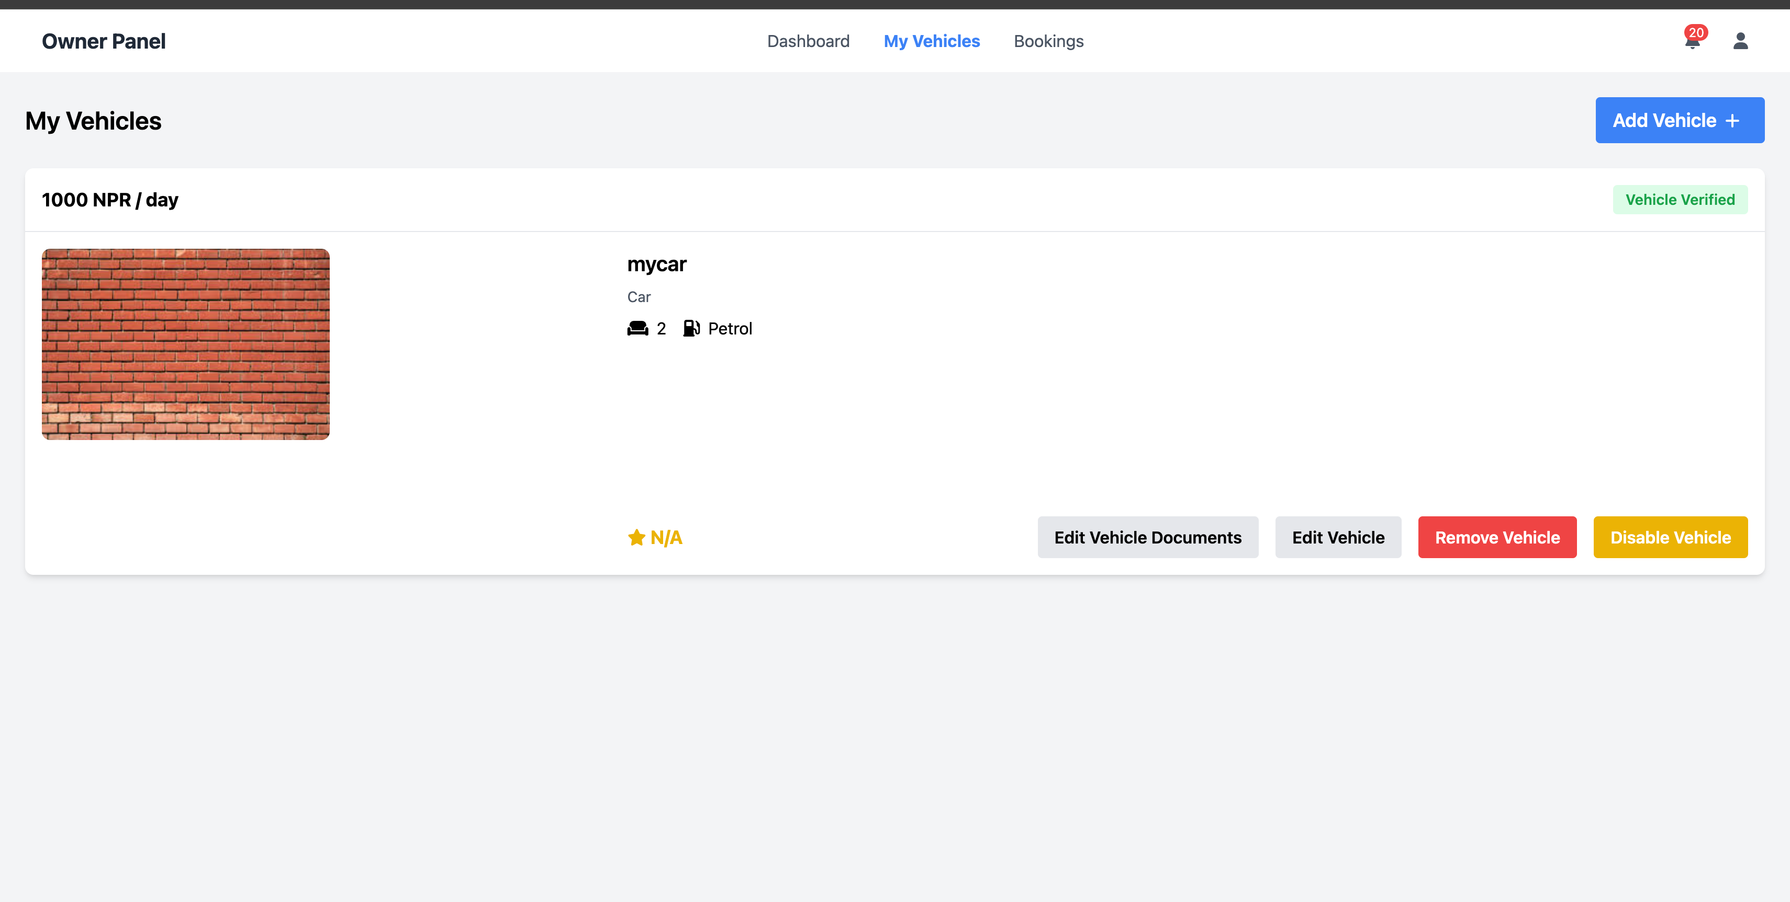
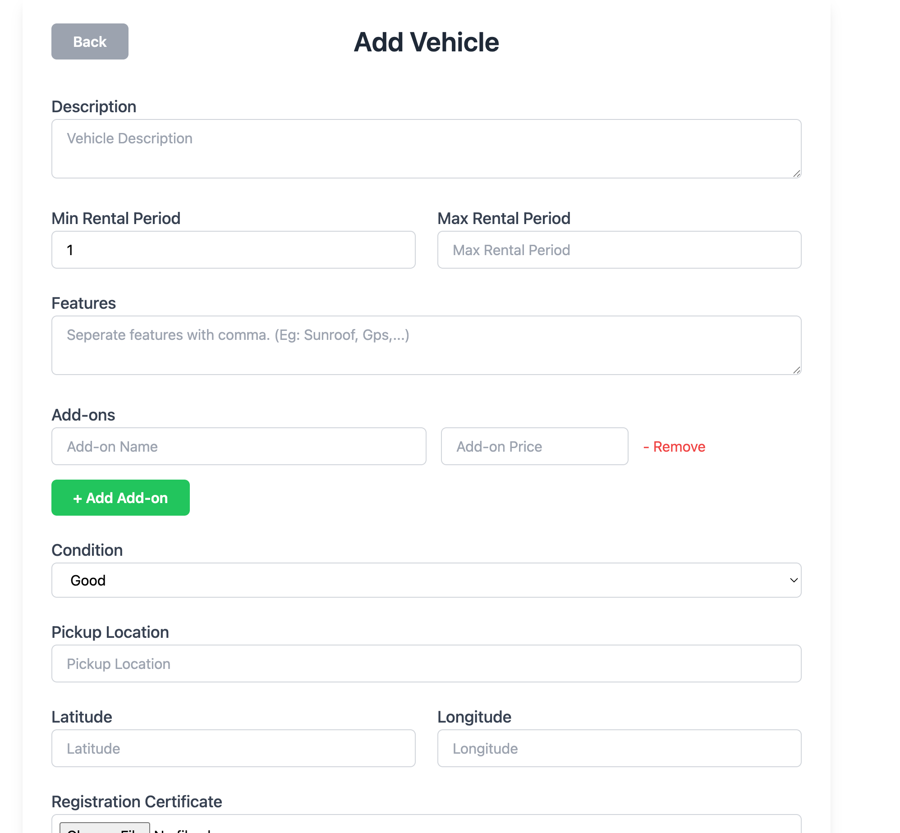
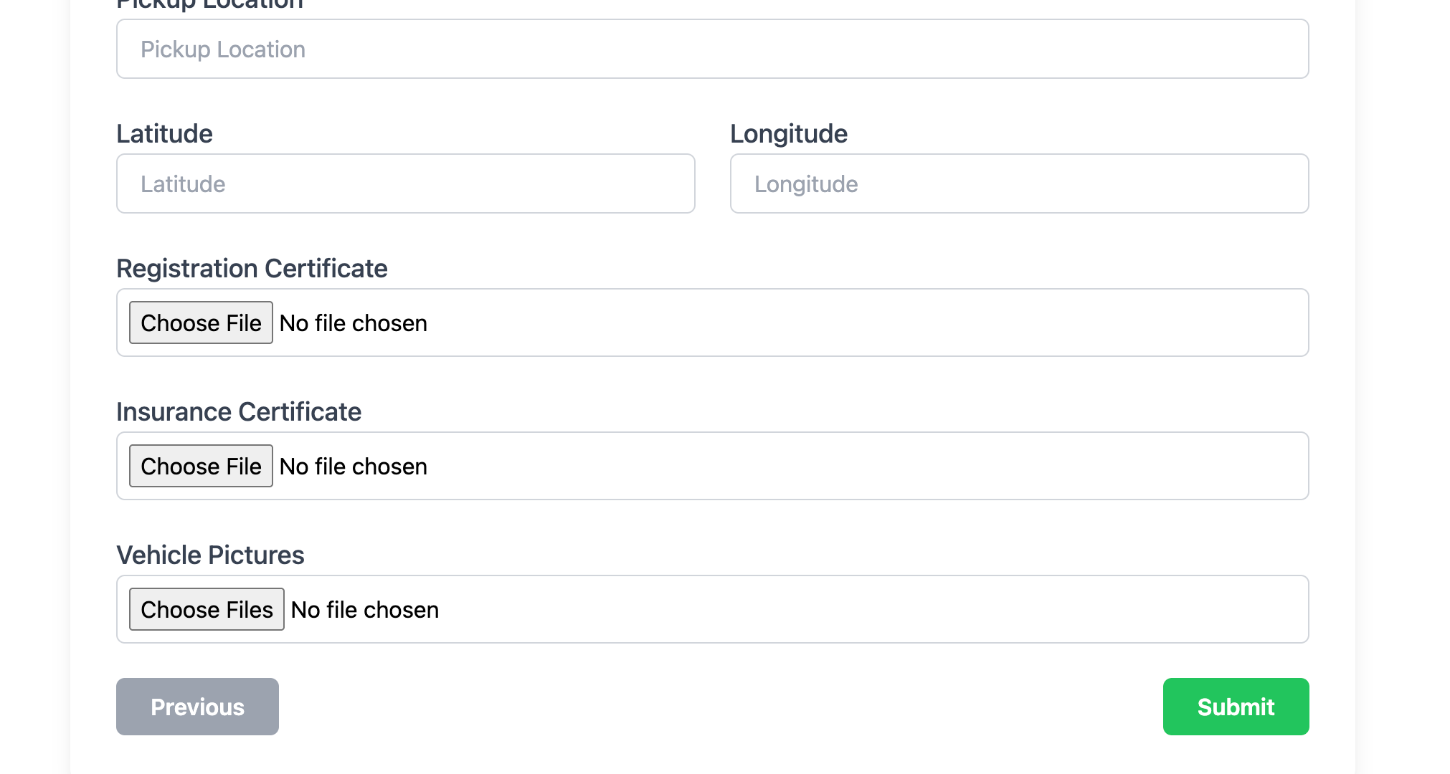
Owner Vehicles

Slide 17
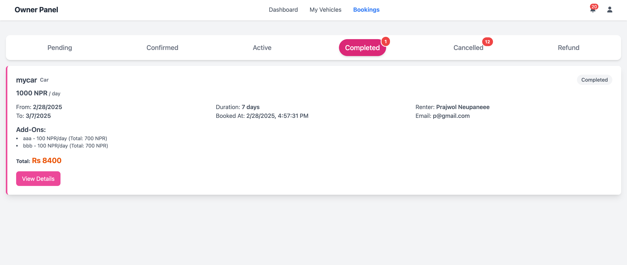
Owner Bookings

Slide 18
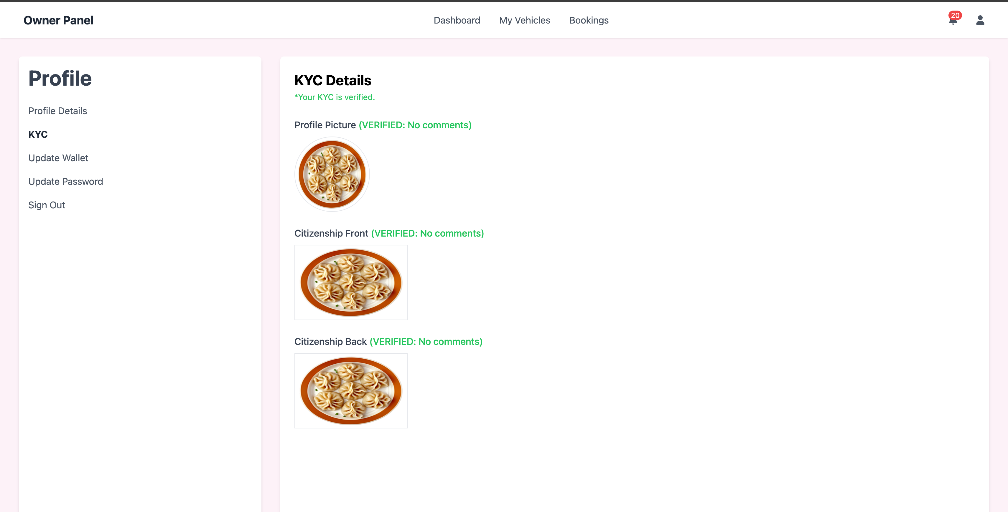
Owner KYC

Slide 19
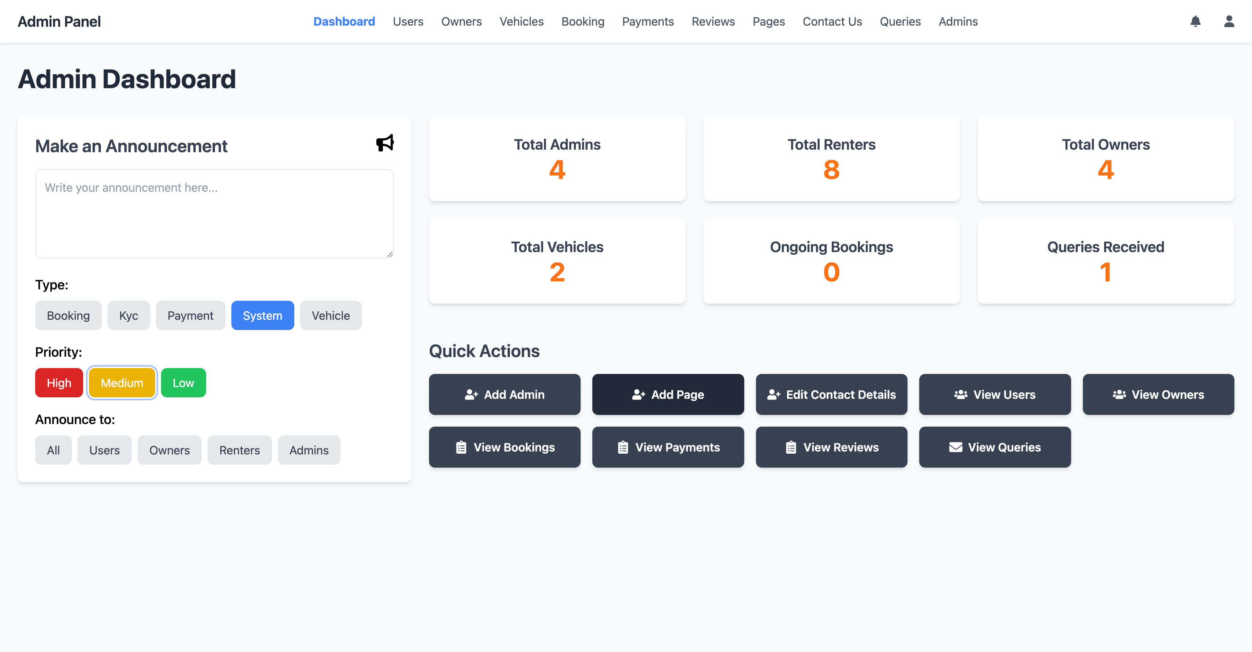
Admin

Slide 20
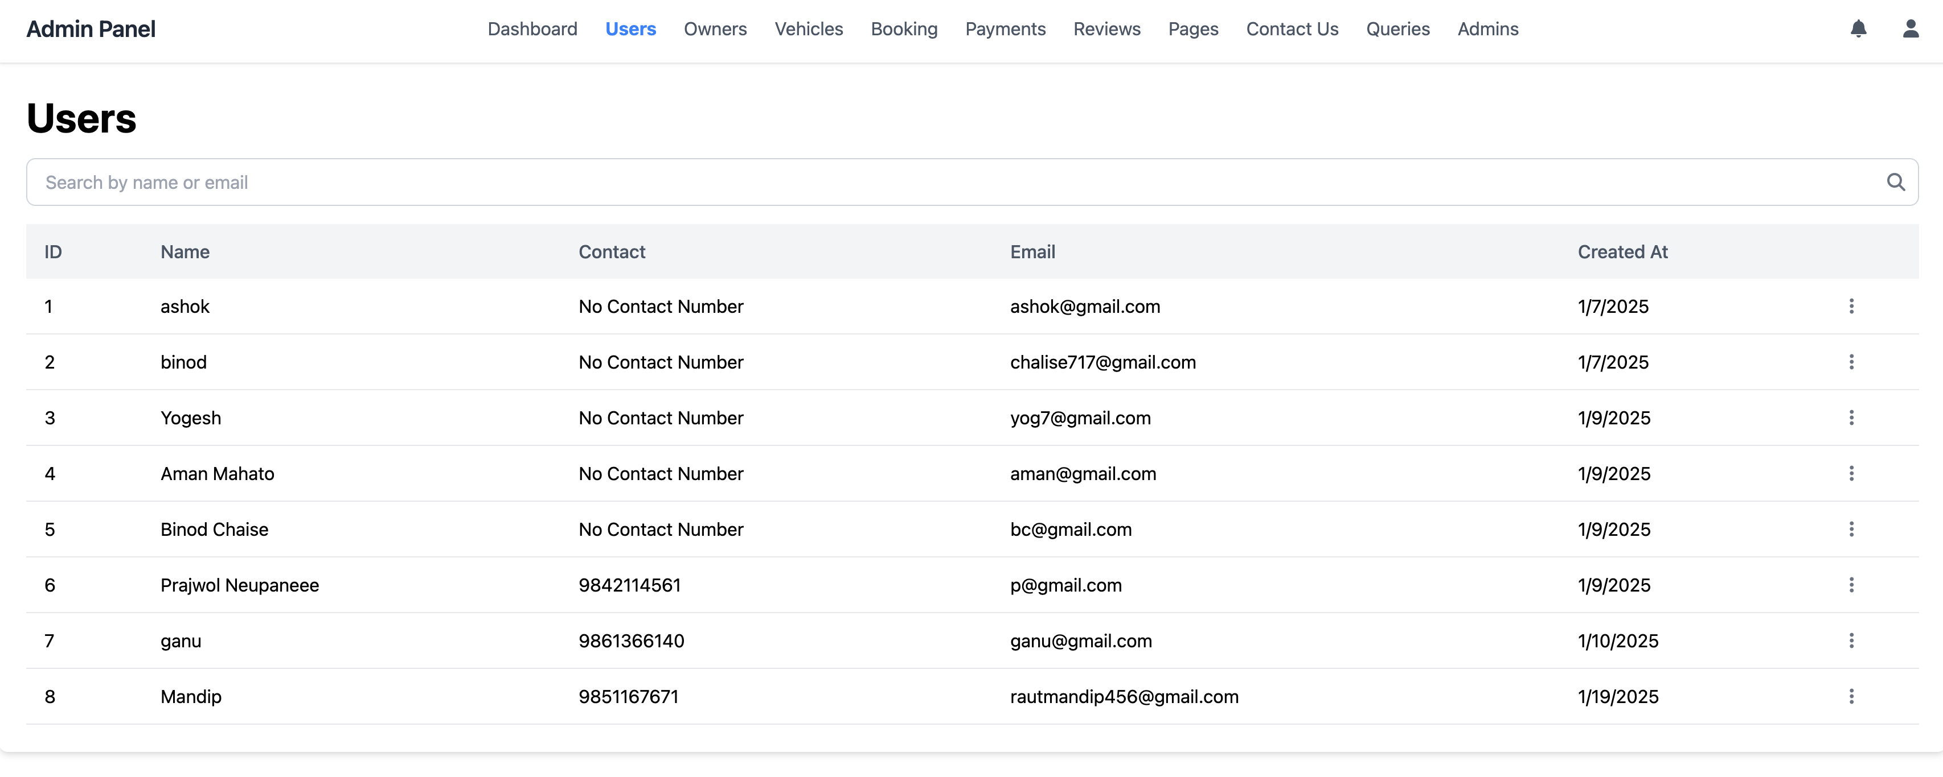
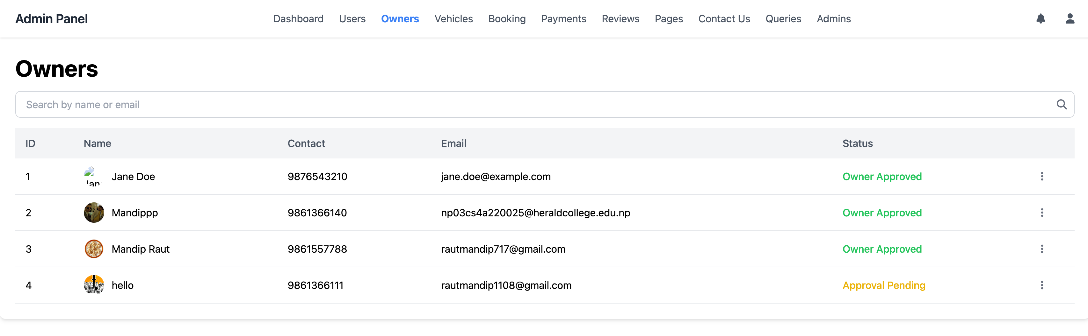
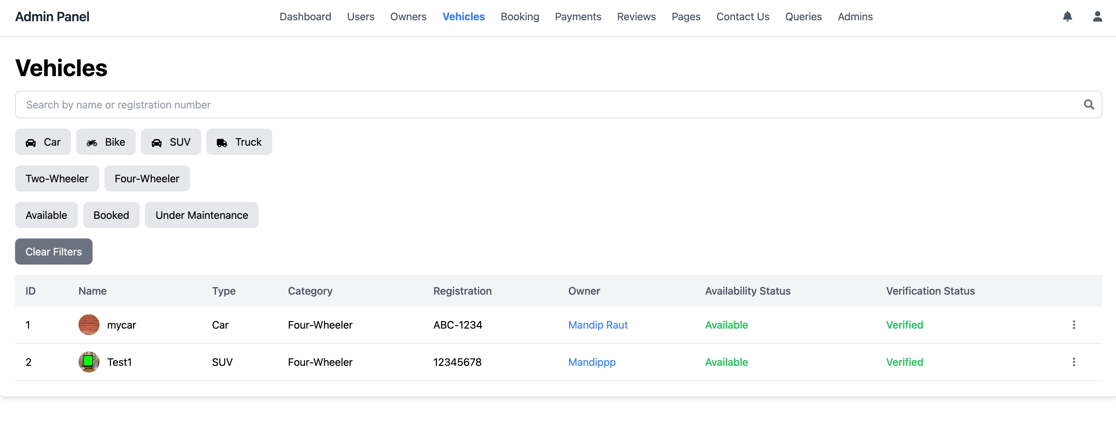
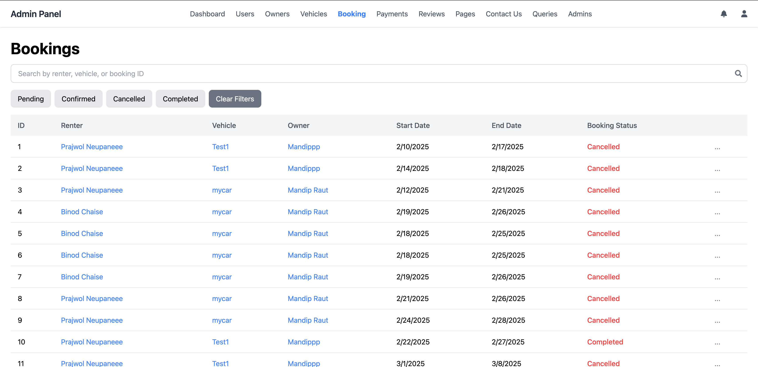
Admin -Continue

Slide 21
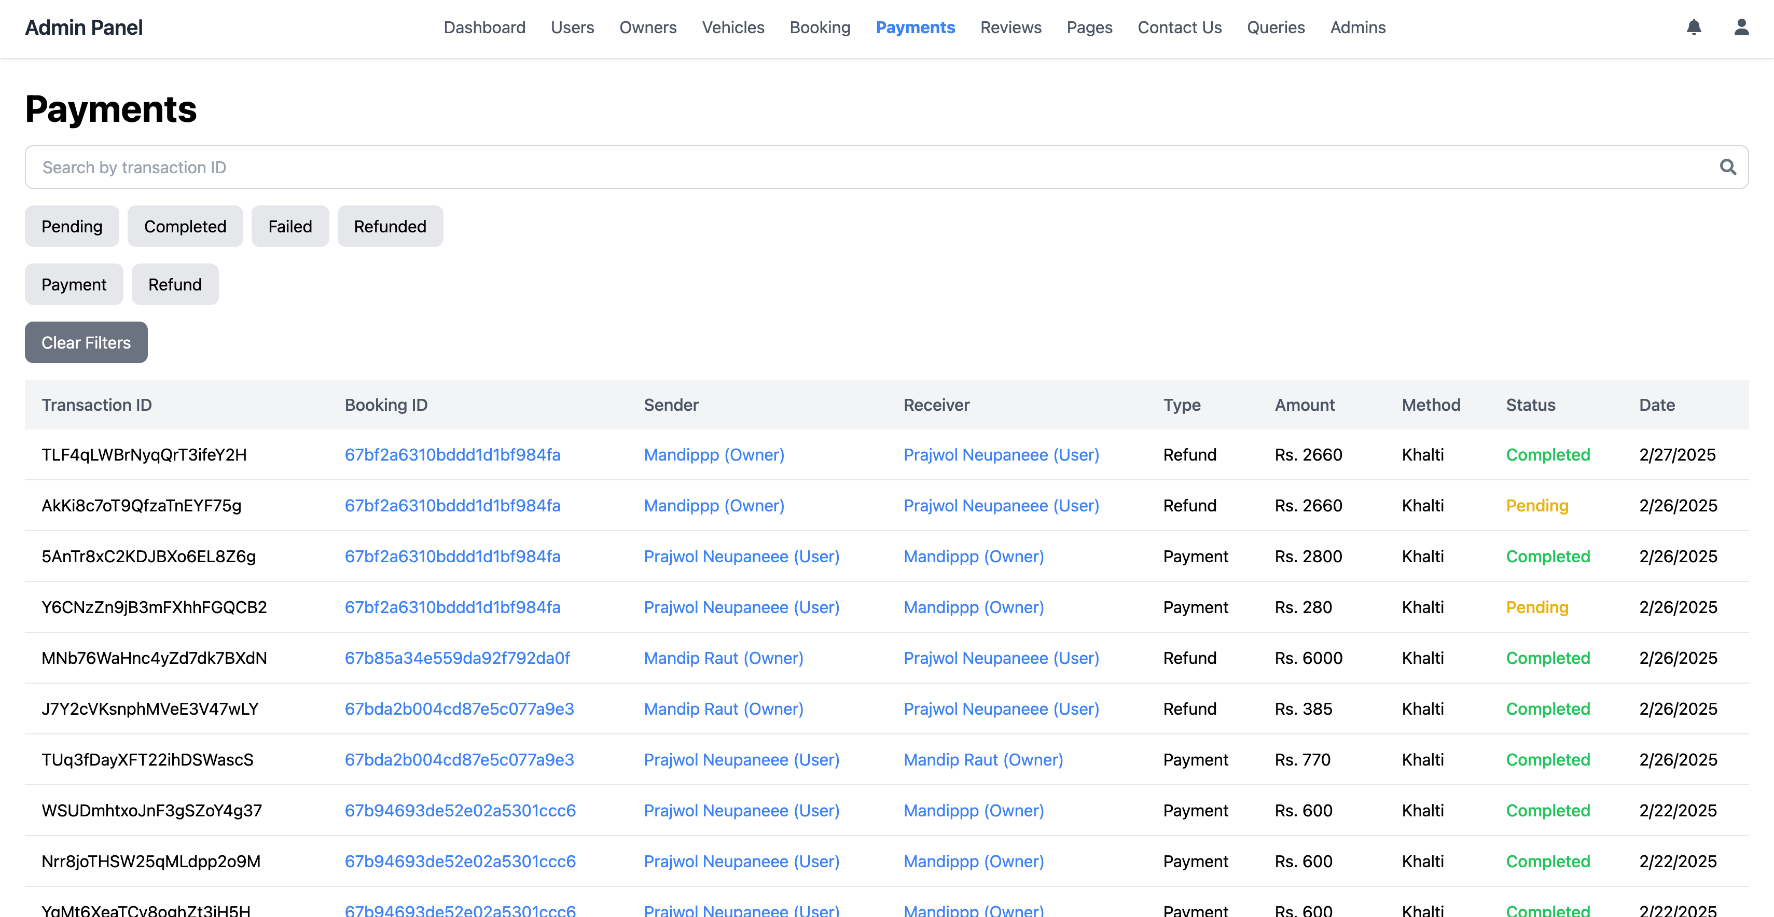
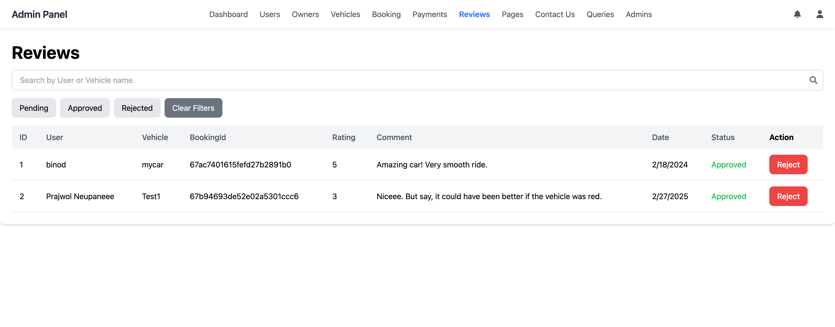
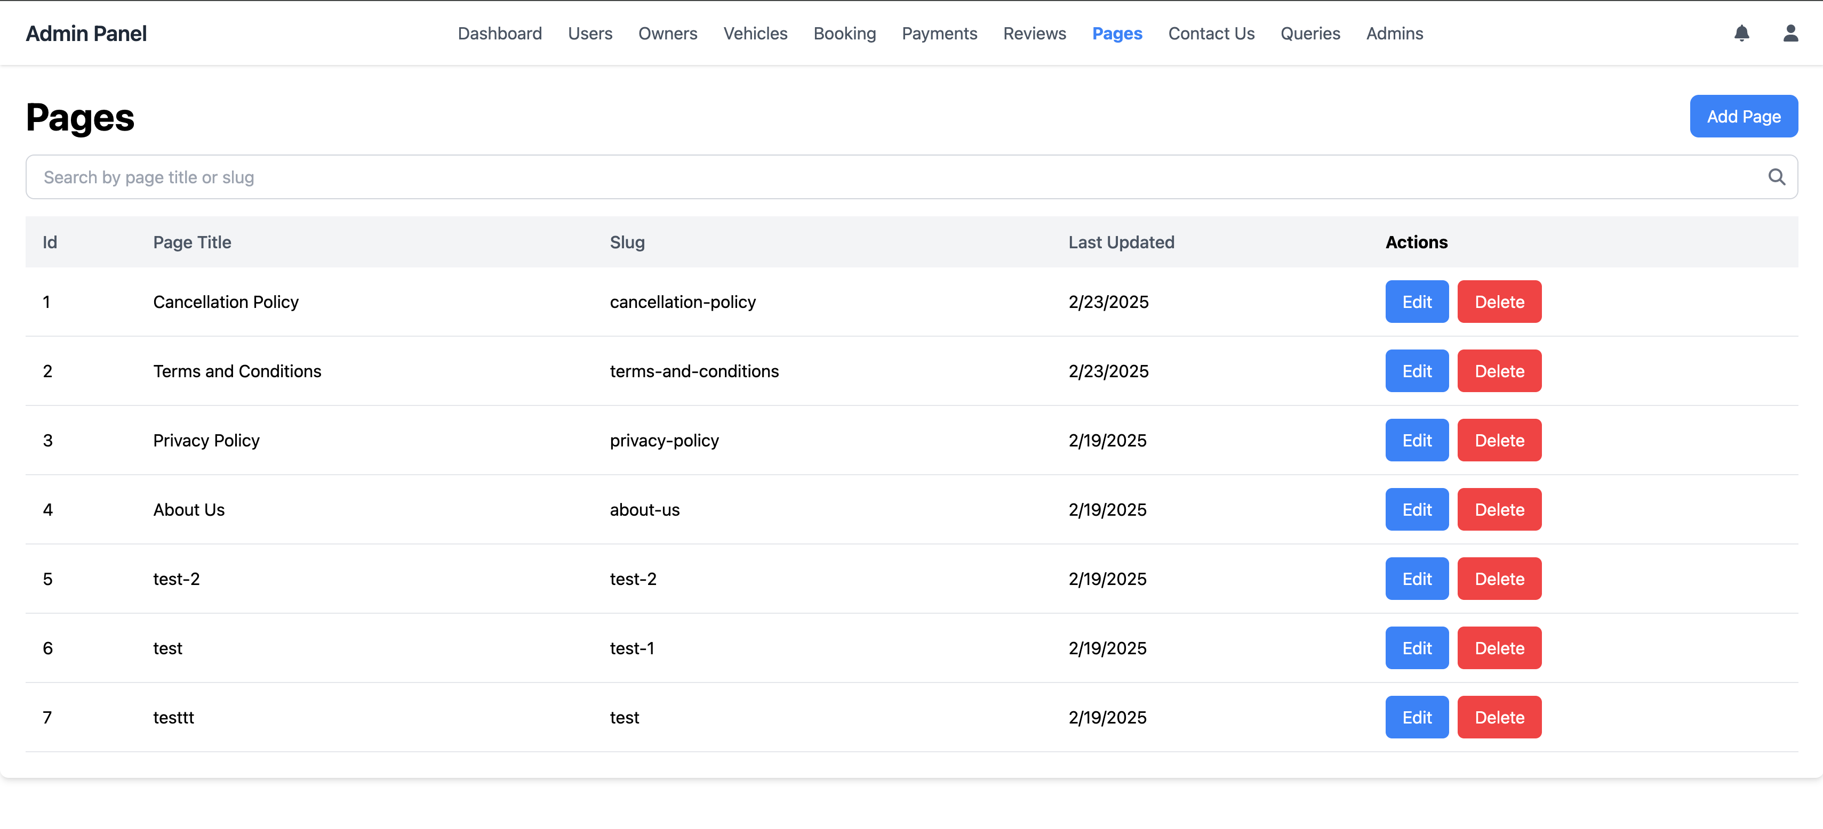
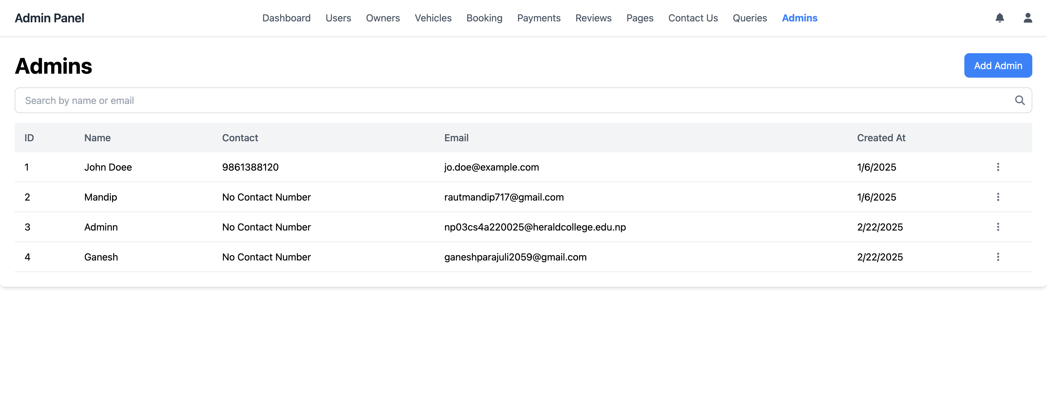
Admin -Continue

Slide 22
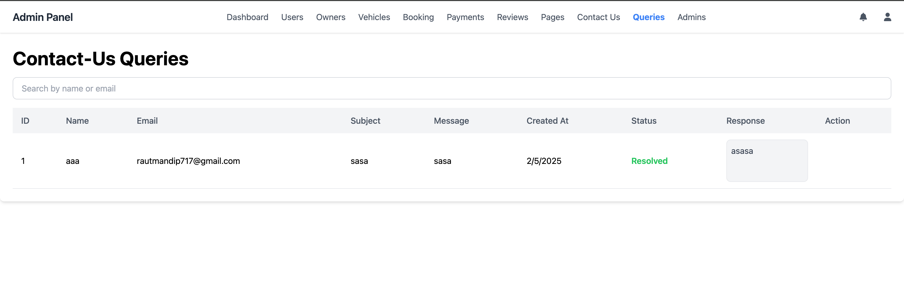
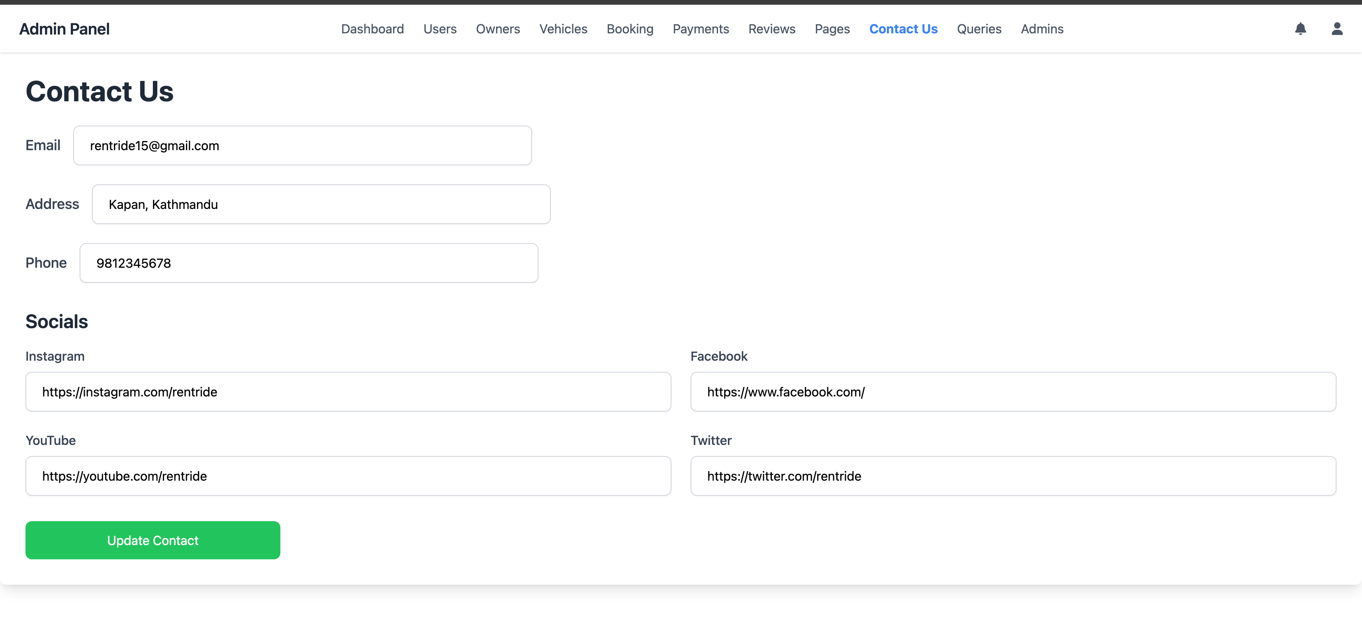
Admin -Continue

Slide 23
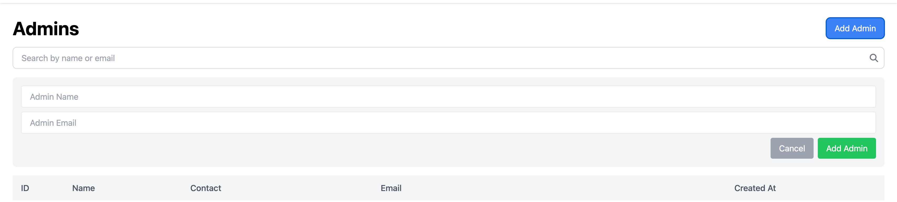
Admin Add-Admin

Slide 24
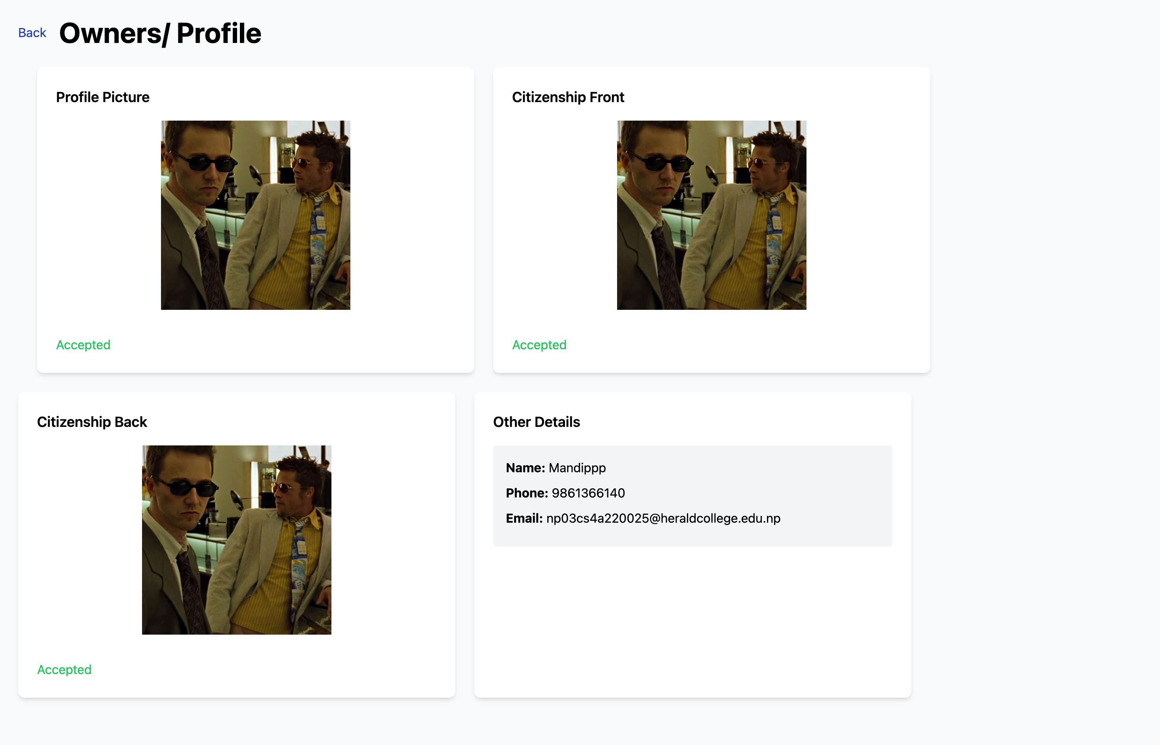
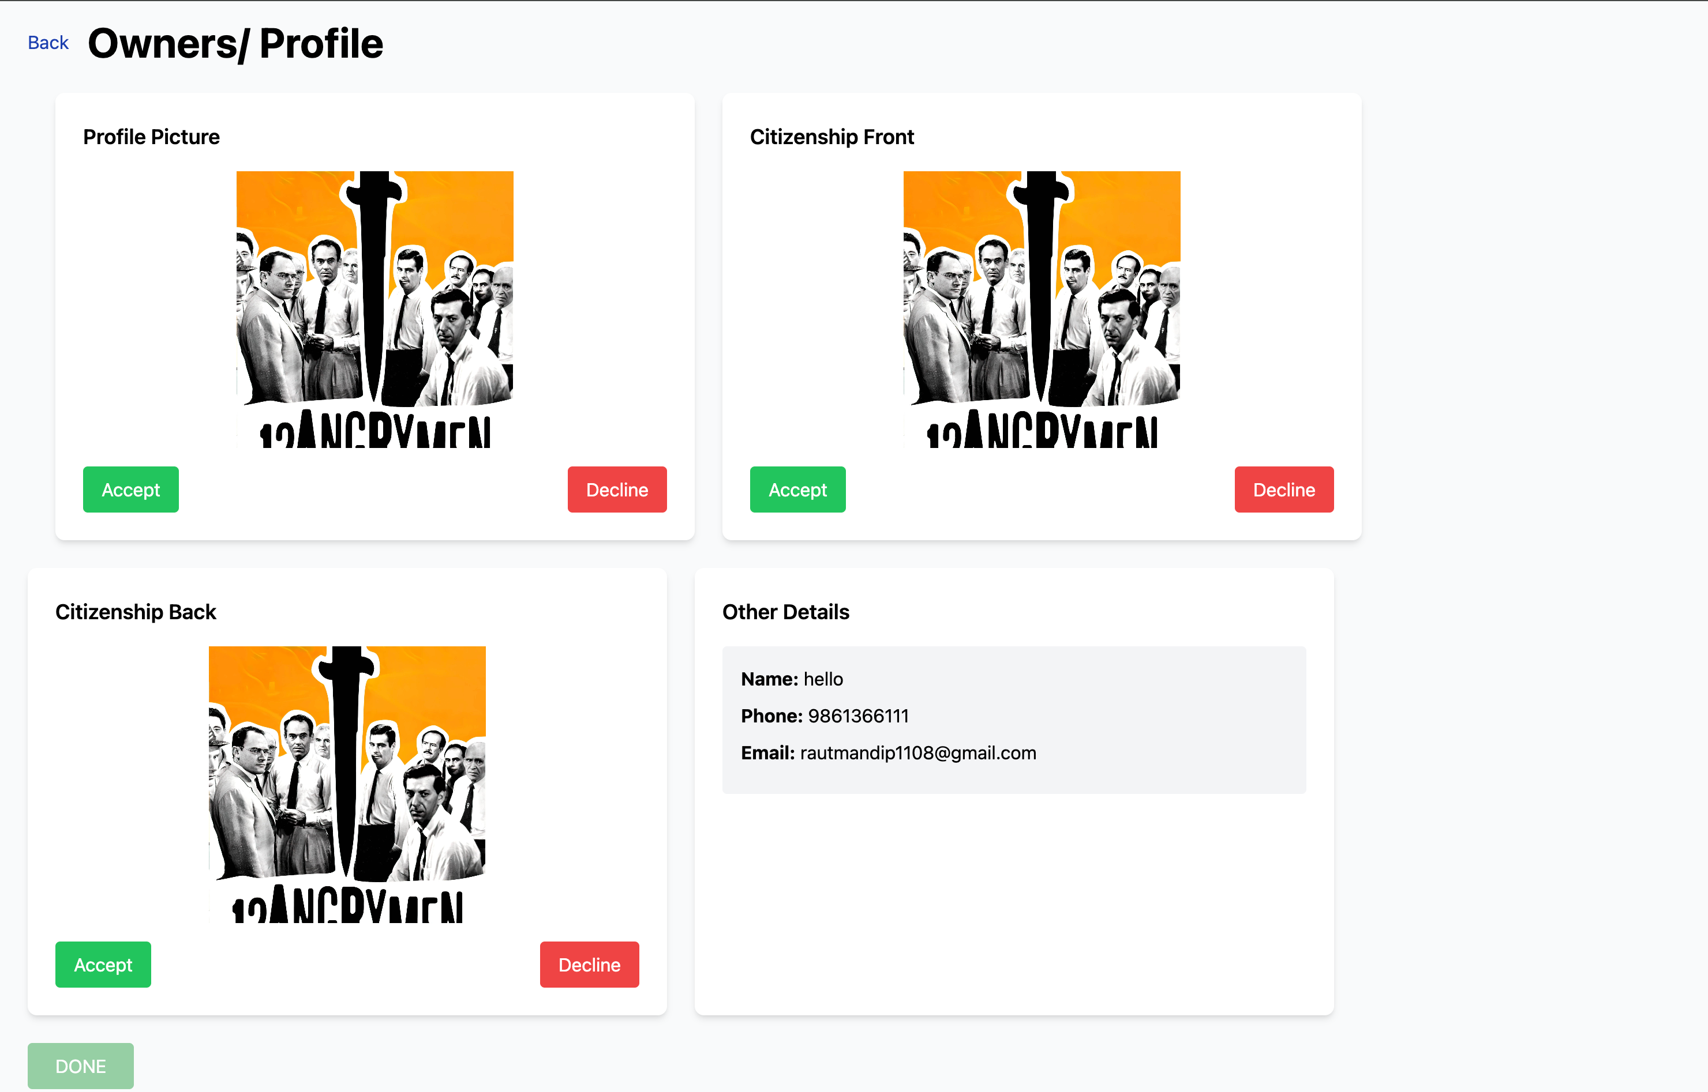
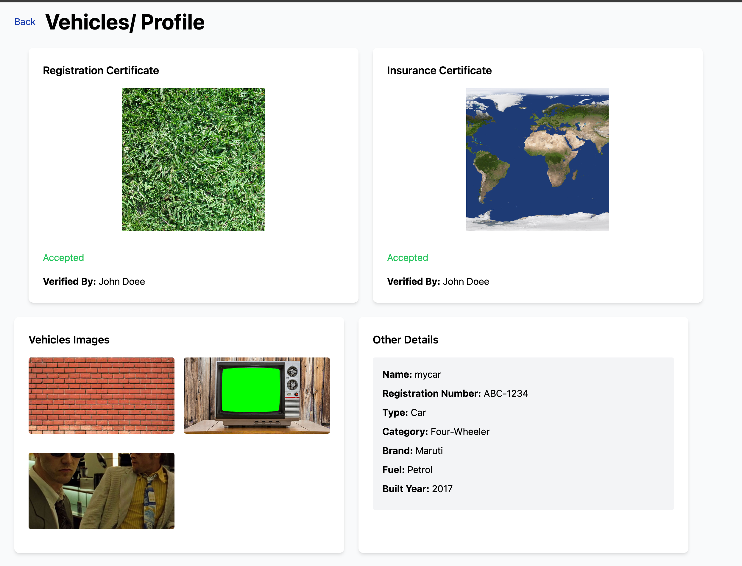
Admin KYC Verification

Slide 25
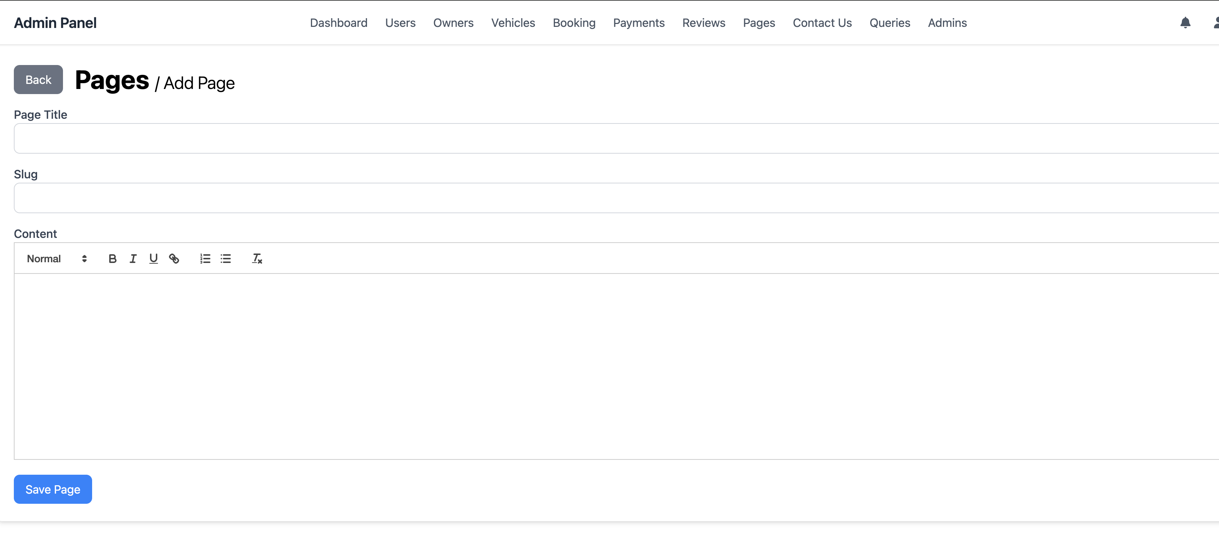
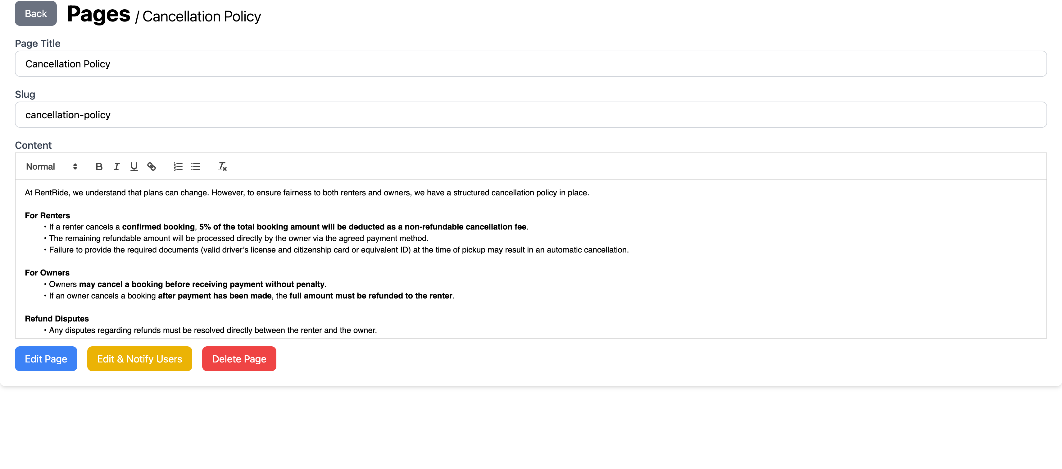
Admin Add/Edit Page

Slide 26
Challenges & Solutions
Challenge 1: Ensuring trust and security.
Users need an application that allows only trusted vehicles to be present.
Solution:
Implemented identity verification and user reviews.
Challenge 2: Pending Vehicle Listings
Some vehicles remain in a pending state even after the rental date has passed.
Solution:
Implemented a Cron Job to periodically check and update outdated pending rentals.
Challenge 3: Secure & Trusted Payment Integration
Users need a reliable and secure payment system to build trust in transactions.
Solution:
Integrated Khalti API for secure and seamless payment processing.
Challenge 4: Real-Time Booking, Notifications & Messaging
Users require instant updates on bookings, payments, and messages.
Solution:
Used Socket.io for real-time communication, ensuring instant booking confirmation, notifications, and live chat.

Slide 27
Conclusion & Future Work
RentRide provides a seamless vehicle rental experience.
Future Enhancements:
AI-based pricing recommendations.
AI-based verification.
GPS-Based Live Tracking.
Loyalty Programs.

Slide 28
Thank You

